Slide 1
EUROMARINE SUMMER SCHOOL
“PulseOcean: Taking an interdisciplinary pulse on ocean under global change”
Ischia, Italy. September 2025
Massimiliano Corsini

Slide 2
Deep Learning for underwater monitoring
September 19, 2025
Machine learning, an introduction
Massimiliano Corsini
Visual Computing Lab, ISTI-CNR

Slide 3
Overview
What is AI, Machine Learning, and Deep Learning
Basics concepts and terminology
Convolutional Neural Networks (CNN)
Visual transformers (ViT)

Slide 4
Part of these slides are taken from a CVPR 2014 tutorial:
Large-Scale Visual Recognition - Part IV: Deep Learning (Marc’Aurelio Ranzato)
Parts are adapted from Lorenzo Baraldi’s lectures (University of Modena and Reggio Emilia)

Slide 5
Basics concepts and terminology

Slide 6
Artificial Intelligence and Machine Learning
Artificial intelligence is a branch of Computer Science devoted to the development of hardware and software systems able to exhibit intelligent behavior (make decisions, understand speech or images, solve simple problems, etc.)
Machine learning is a part of AI which regards the algorithms that learns from the data and the experience.
→ What we mean for learning ?
A computer program is said to learn from experience E with respect to some class of tasks T and performance measure P, if its performance at tasks in T, as measured by P, improves with experience E. (Mitchell, 1997)

Slide 7
Tasks
Speech recognition → the intelligent system recognizes what a human said
Image captioning → the system provides a textual description of a picture
Action recognition → automatically recognize the actions performed by humans in videos
Anomaly detection → finding something that is unusual, e.g. an object that should not be present in a given scene
Time series prediction → prediction of the temporal evolution of a signal/signals in the future (e.g. predict short term stock exchange performance)
Image recognition → the system is able to automatically recognize the content of a digital image
.. and many many others .

Slide 8
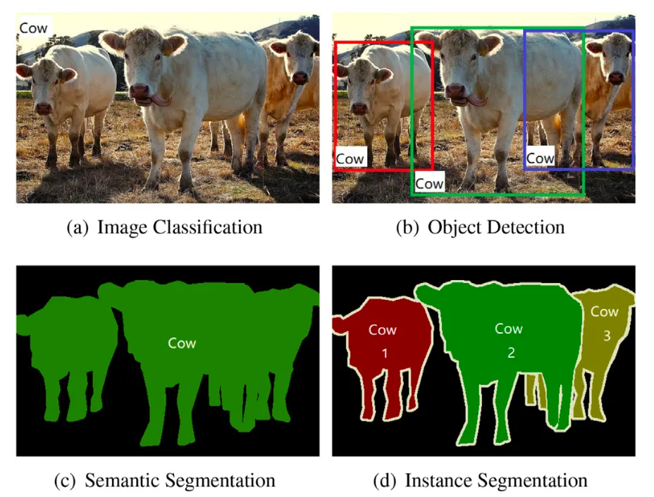
Image Recognition Tasks
Source: https://arxiv.org/abs/1908.03673

Slide 9
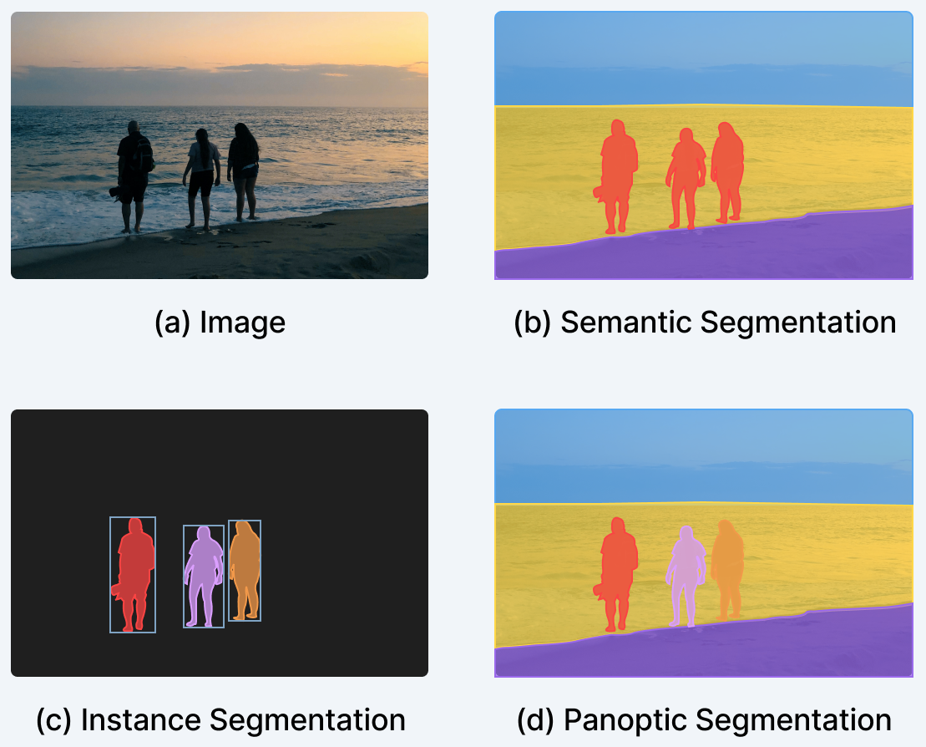
Semantic, instance, and panoptic segmentation
Source: V7 Labs

Slide 10











Machine Learning
Machine Learning is a type of Artificial Intelligence that provides computers with the ability to do a task without being explicitly programmed.
Training Prediction
Provides several techniques that can learn from data and make predictions on new data
Labeled Data
Machine Learning
Algorithm
Data
Learned Model
Prediction

Slide 11




Learning Types
Supervised Learning: Learning with a labeled training set
Example: learn to detect email spam starting from a training set of already labeled emails
Unsupervised Learning: Discovering patterns in unlabeled data
Example: cluster similar documents based on the text content
Reinforcement Learning: learning based on feedback or reward
Example: learn to play chess by winning or losing

Slide 12



Deep Learning
Part of the machine learning field of learning representations of data. Exceptional effective at learning patterns.
Utilizes learning algorithms that derive meaning out of data by using a hierarchy of multiple layers that mimic the neural networks of our brain.
If you provide the system tons of information, it begins to
understand it and respond in useful ways.

Slide 13
Artificial Intelligence
Machine Learning
Deep Learning

Slide 14
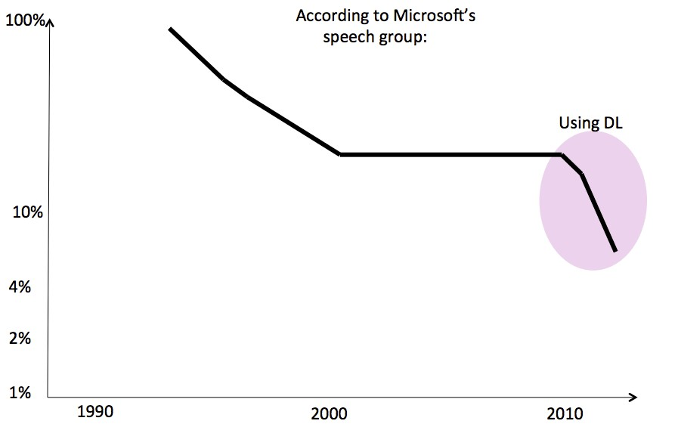
Deep Learning in Speech Recognition

Slide 15
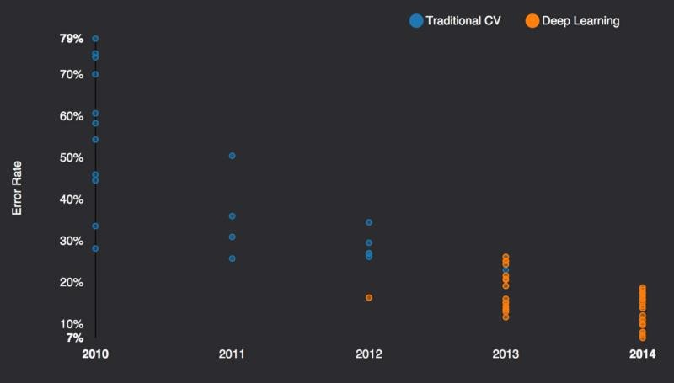
DeepLearning in Computer Vision: ImageNet – the Computer Vision World Cup

Slide 16

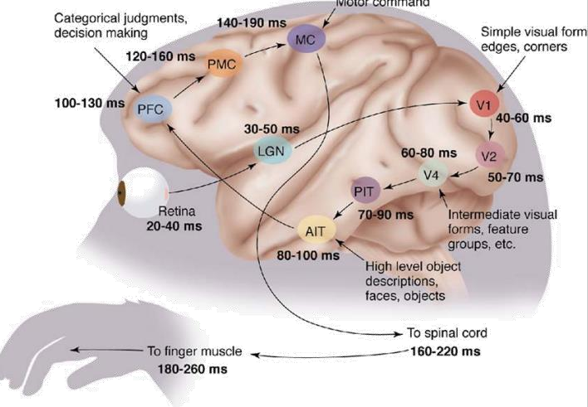


Inspired by the brain
The first hierarchy of neurons that receives information in the visual cortex are sensitive to specific edges while brain regions further down the visual pipeline are sensitive to more complex structures such as faces.
Our brain has lots of neurons connected together and the strength of the connections between neurons represents long term knowledge.
1
One learning algorithm hypothesis: all significant mental algorithms
are learned except for the learning and reward machinery itself.

Slide 17


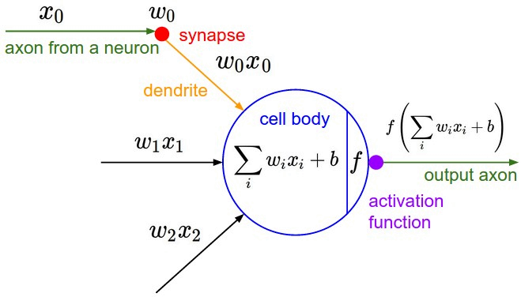


Artificial neuron
An artificial neuron contains a nonlinear activation function and has
several incoming and outgoing weighted connections.
Neurons are trained to filter and detect specific features or patterns (e.g. edge, nose) by receiving weighted input, transforming it with the activation function und passing it to the outgoing connections.

Slide 18
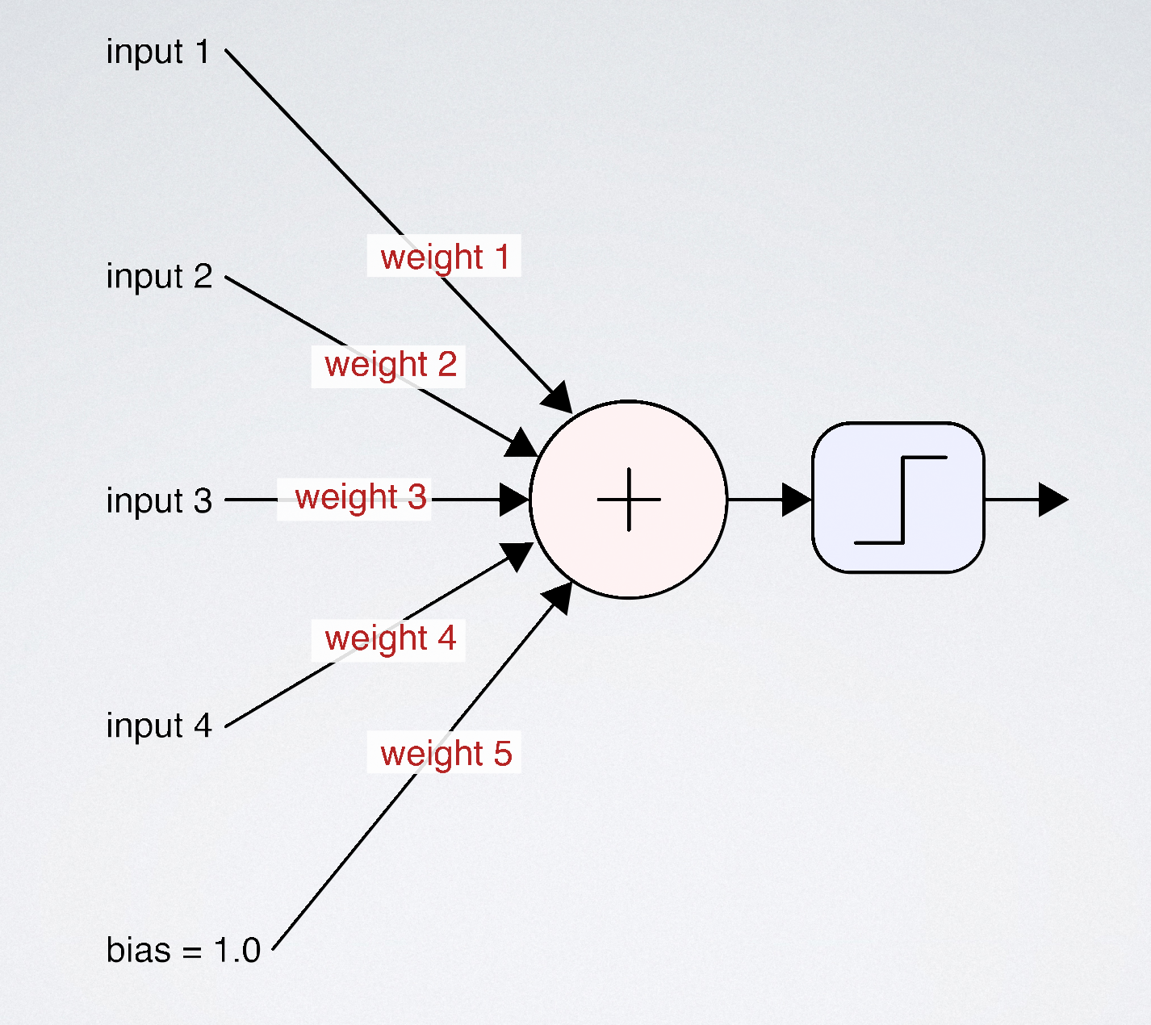
Artificial neuron
A weighted sum of the input (∑)
Activation function
(e.g. max(0, ∑))
Source: A. Glassner. Deep learning: a crash course, SIGGRAPH 2018 https://dl.acm.org/doi/10.1145/3214834.3214856

Slide 19
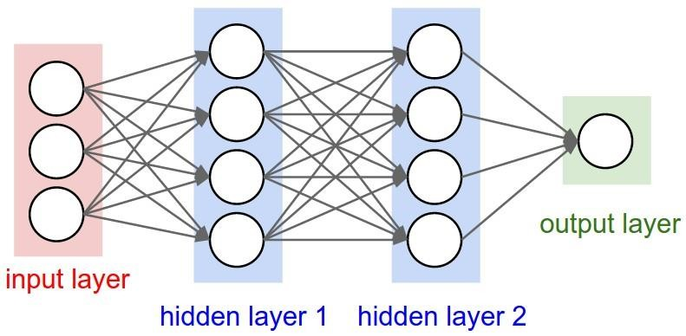
From artificial neuron to artificial neural network
Consists of one input, one output and multiple fully-connected hidden layers in- between. Each layer is represented as a series of neurons and progressively extracts higher and higher-level features of the input until the final layer essentially makes a decision about what the input shows. The more layers the network has, the higher- level features it will learn.

Slide 20
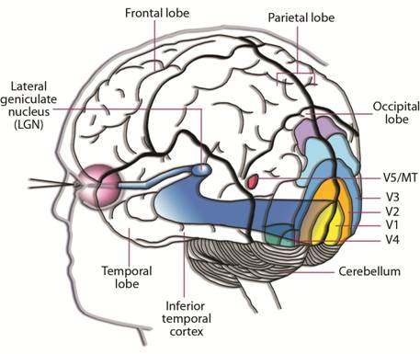
Human Visual Perception
LGN (Lateral Geniculate Nucleus) forwards pulses to V1. It is also connected with V2 and V3
V1 is the primary visual cortex. It performs edge detection and global organization (inputs from V2, V3)
V2 handles depth, foreground, illusory contours
V3 supports global motion understanding
V4 recognizes simple geometric shape
V5/MT: motion perception integration and eye movements guidance

Slide 21
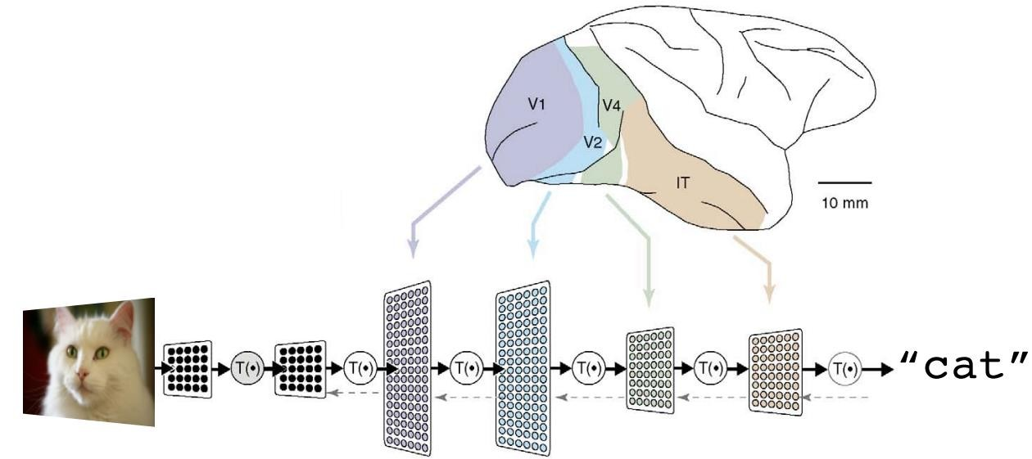
Deep learning vs human brain
A deep neural network consists of a hierarchy of layers, whereby each layer transforms the input data into more abstract representations (e.g. edge -> nose -> face). The output layer combines those features to make predictions.

Slide 22
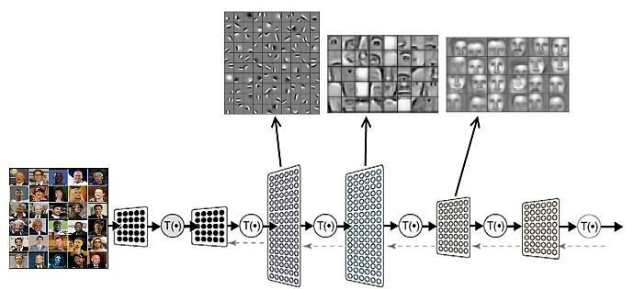
What did it learn?

Slide 23
How neural networks learns?

Slide 24
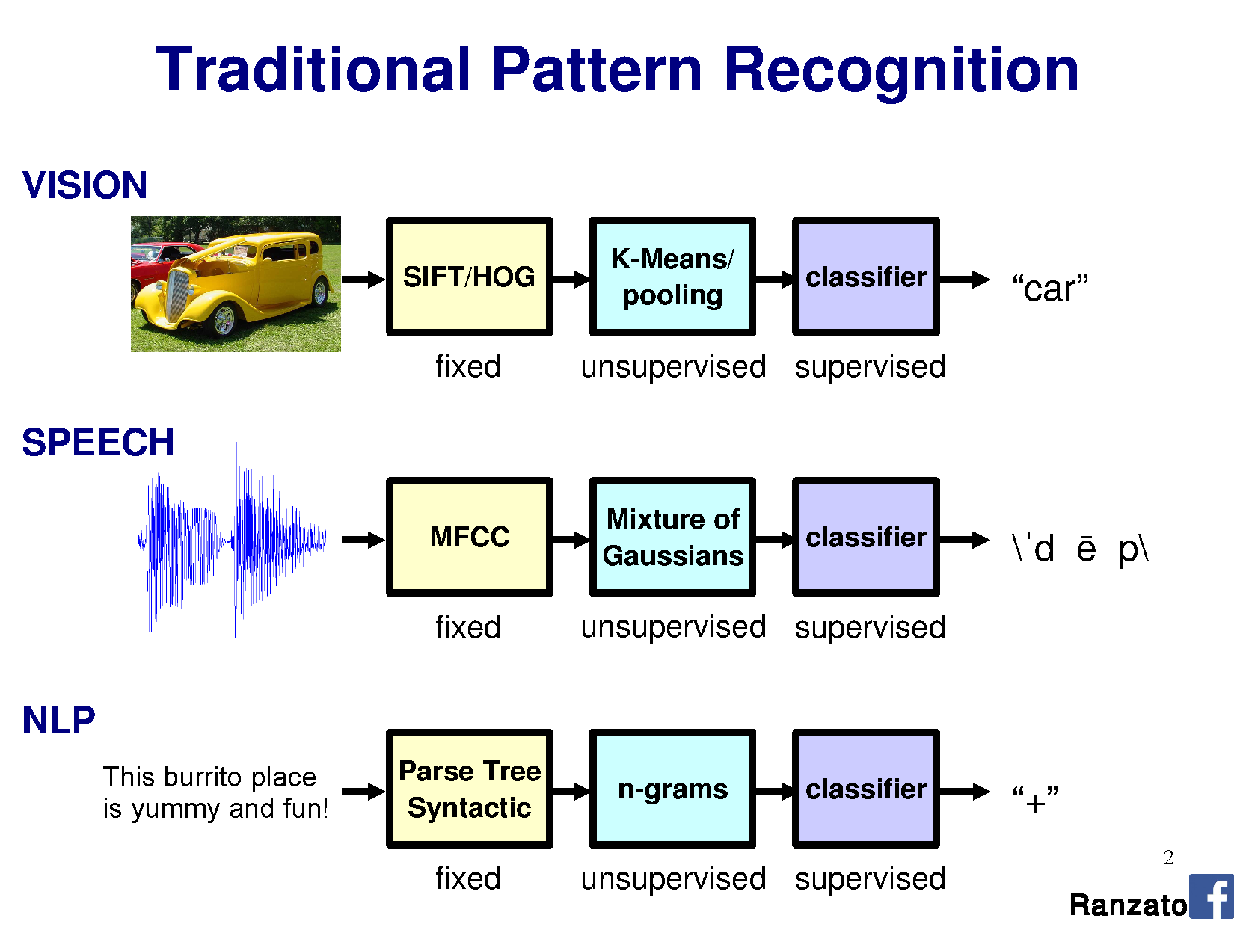

Slide 25
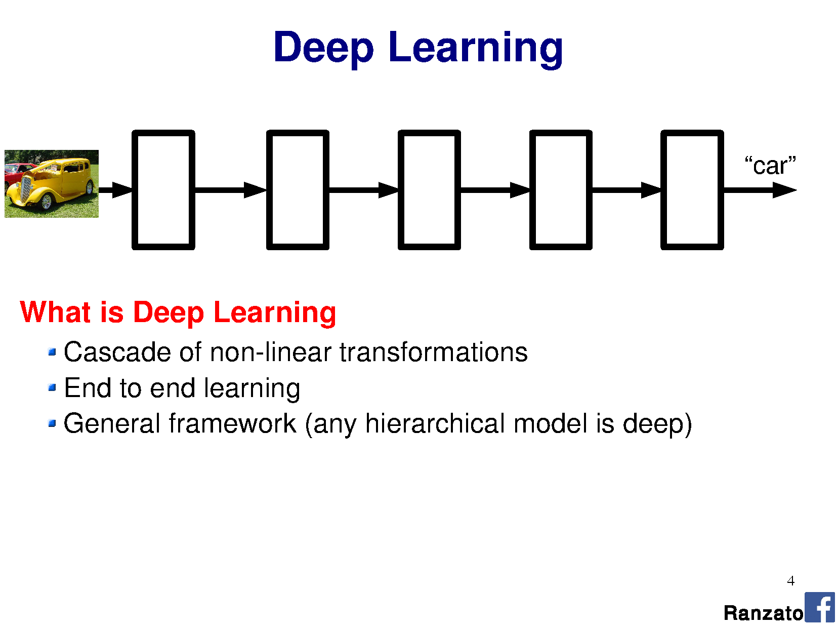
WE DO NOT NEED TO ENGINEERING FEATURE EXTRACTION (!)

Slide 26
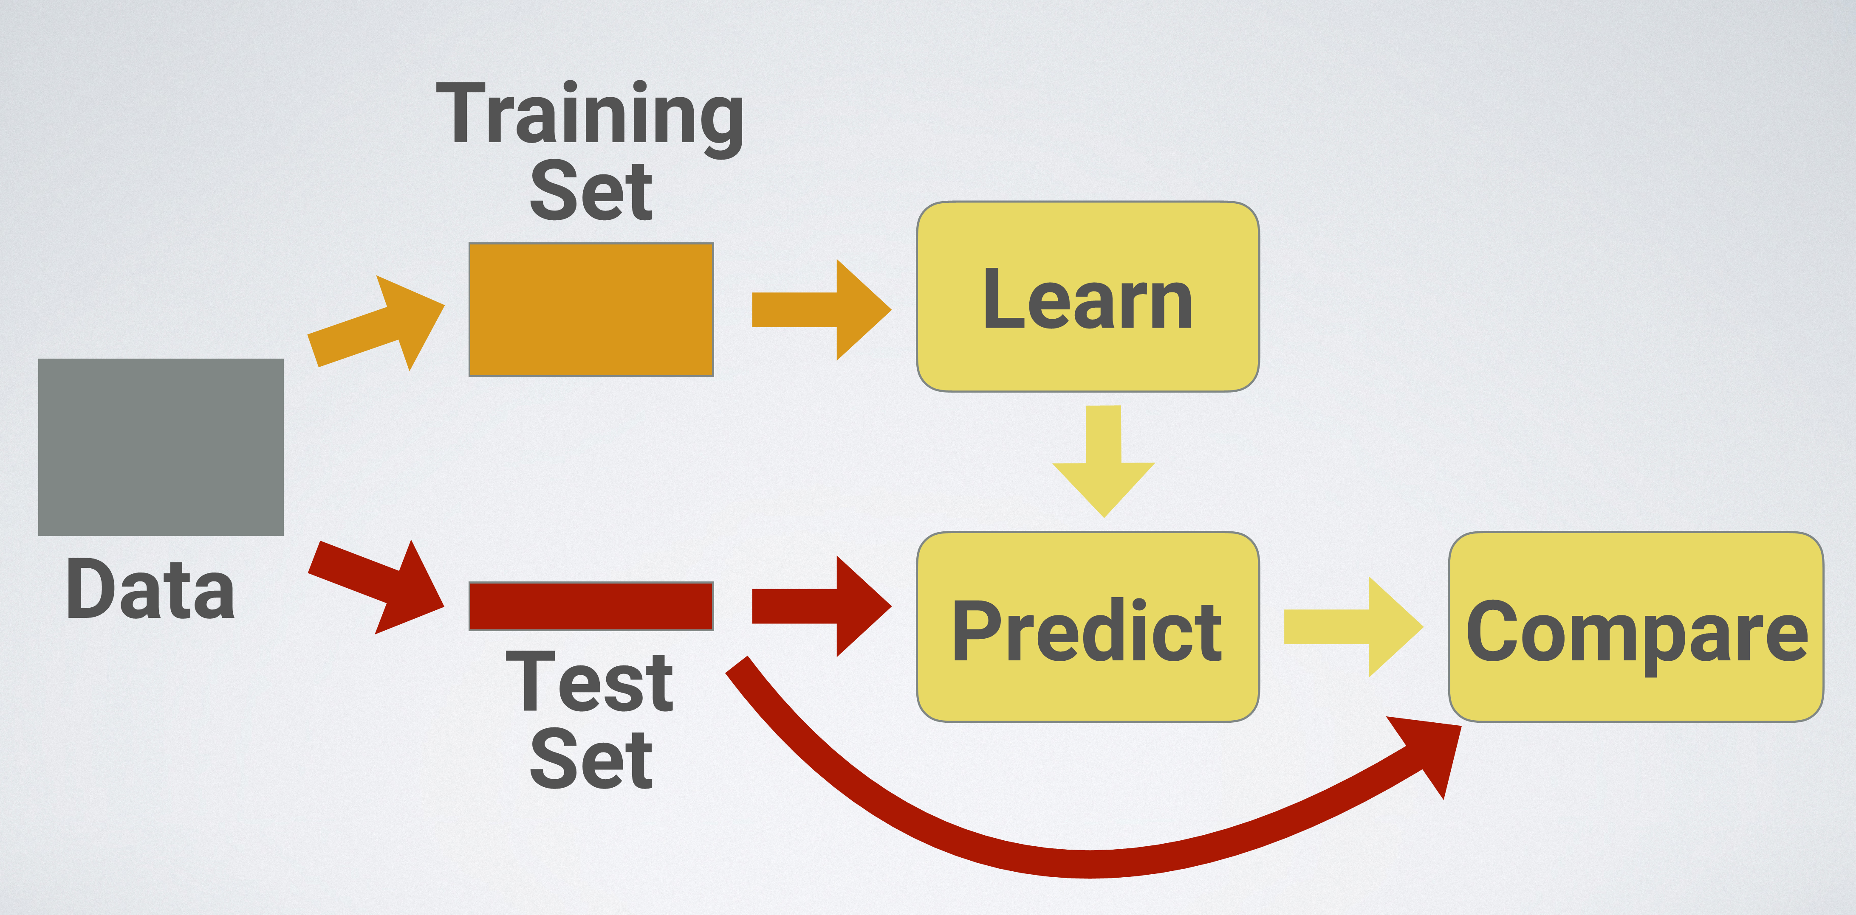
Supervised learning
[A. Glassner. Deep learning: a crash course, SIGGRAPH 2018 https://dl.acm.org/doi/10.1145/3214834.3214856]

Slide 27
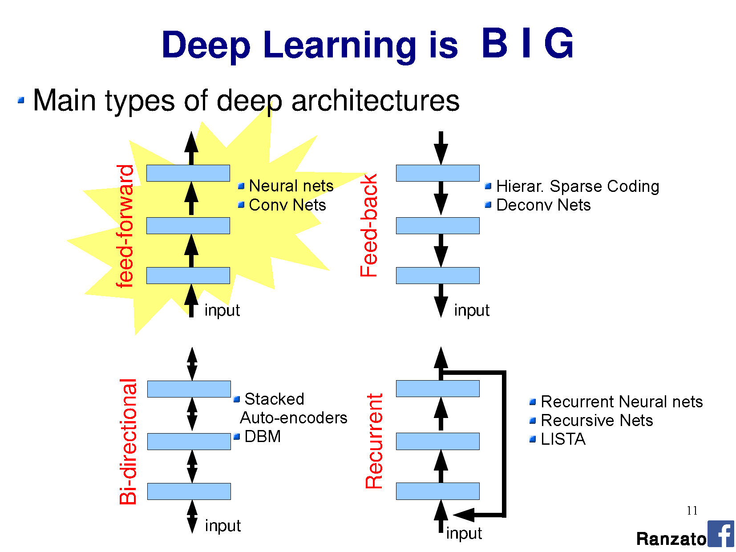

Slide 28
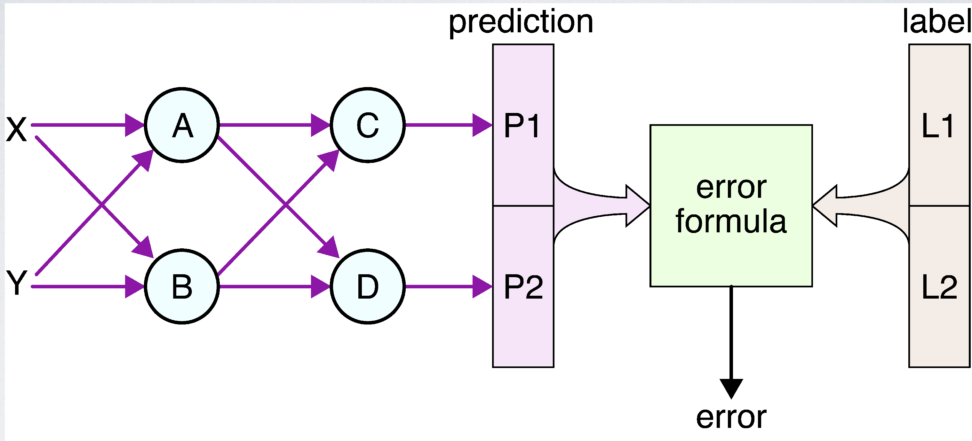
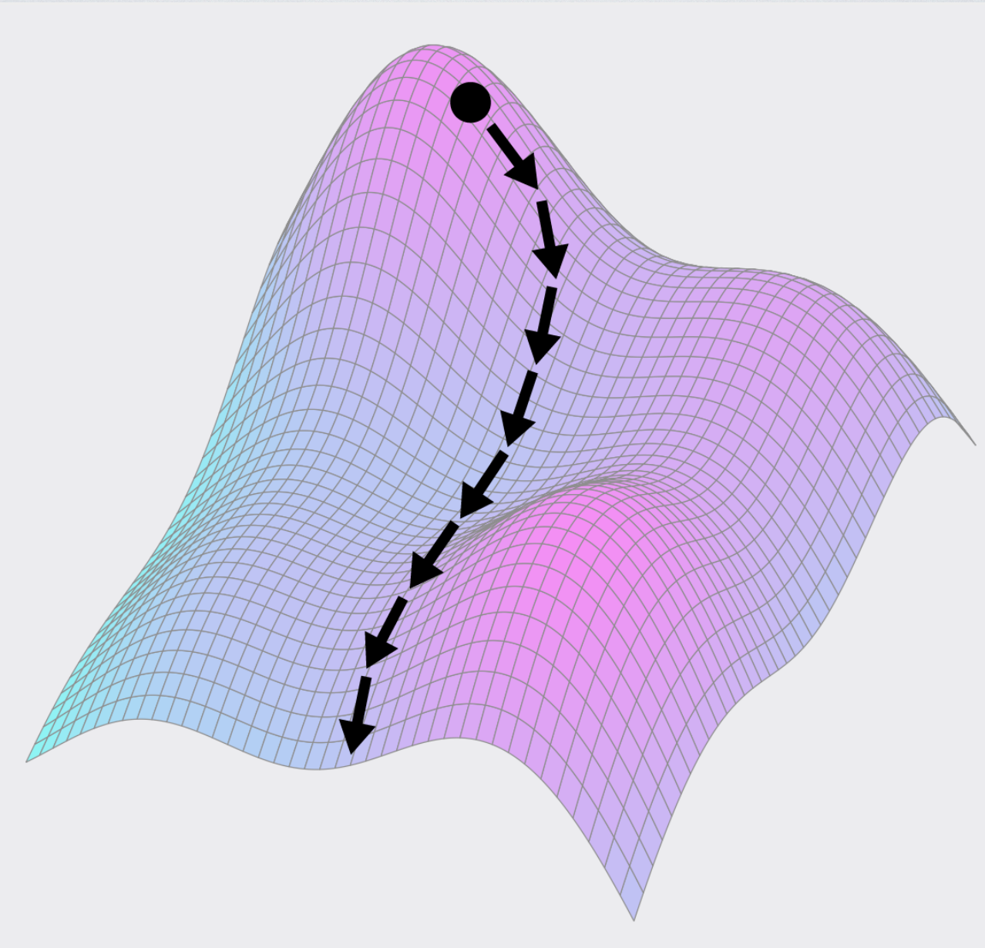
Learning via error minimization
Ground truth
[A. Glassner. Deep learning: a crash course, SIGGRAPH 2018 https://dl.acm.org/doi/10.1145/3214834.3214856]

Slide 29
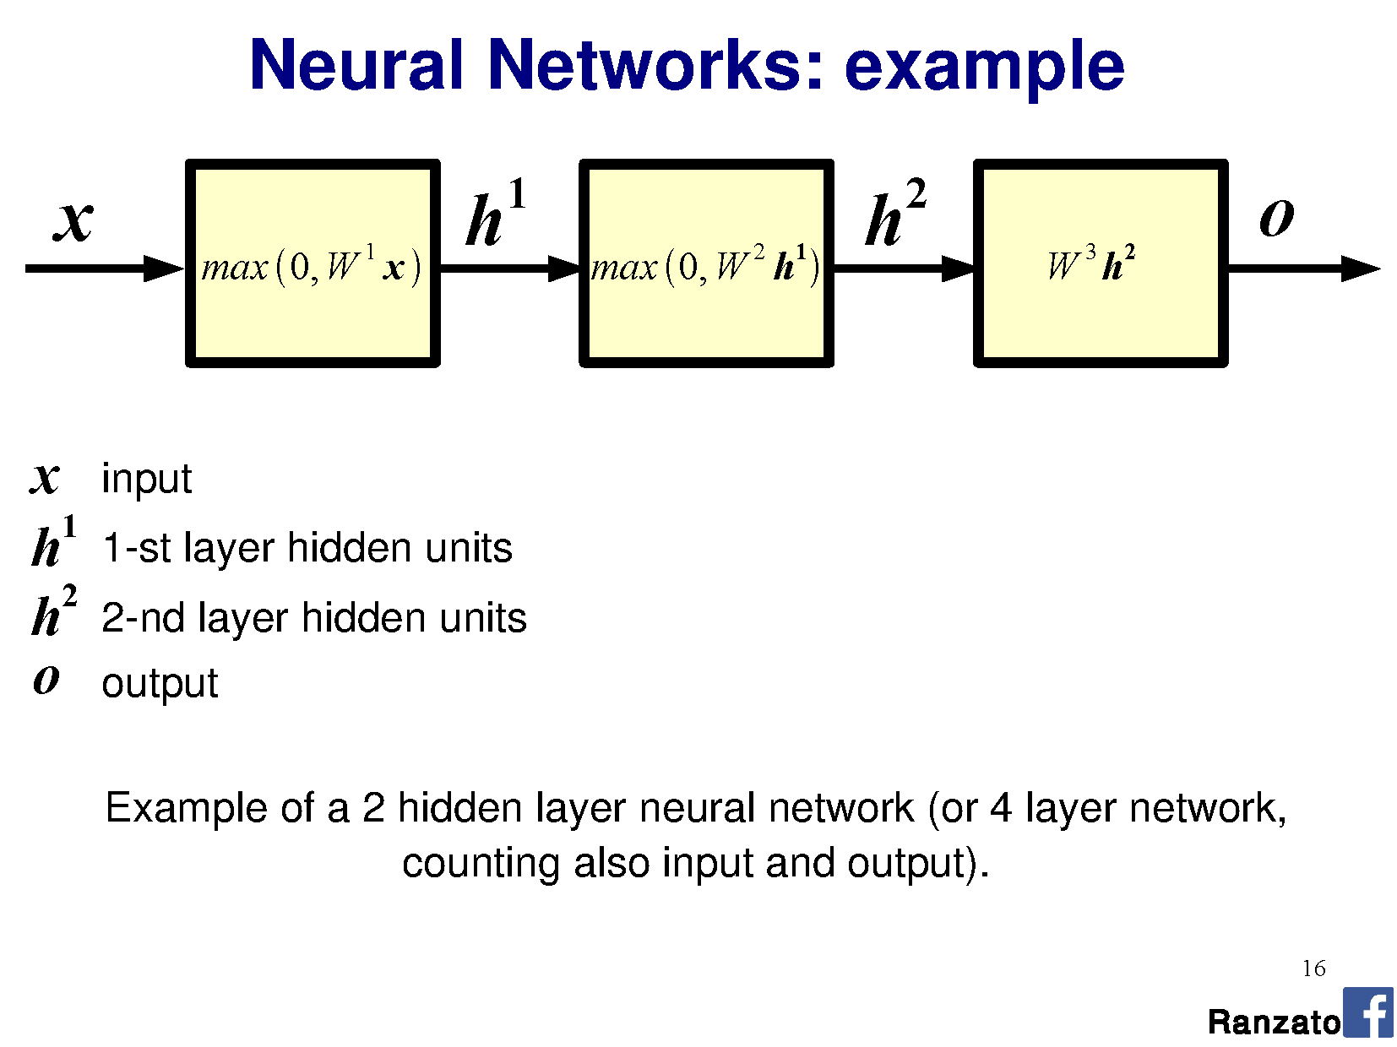

Slide 30
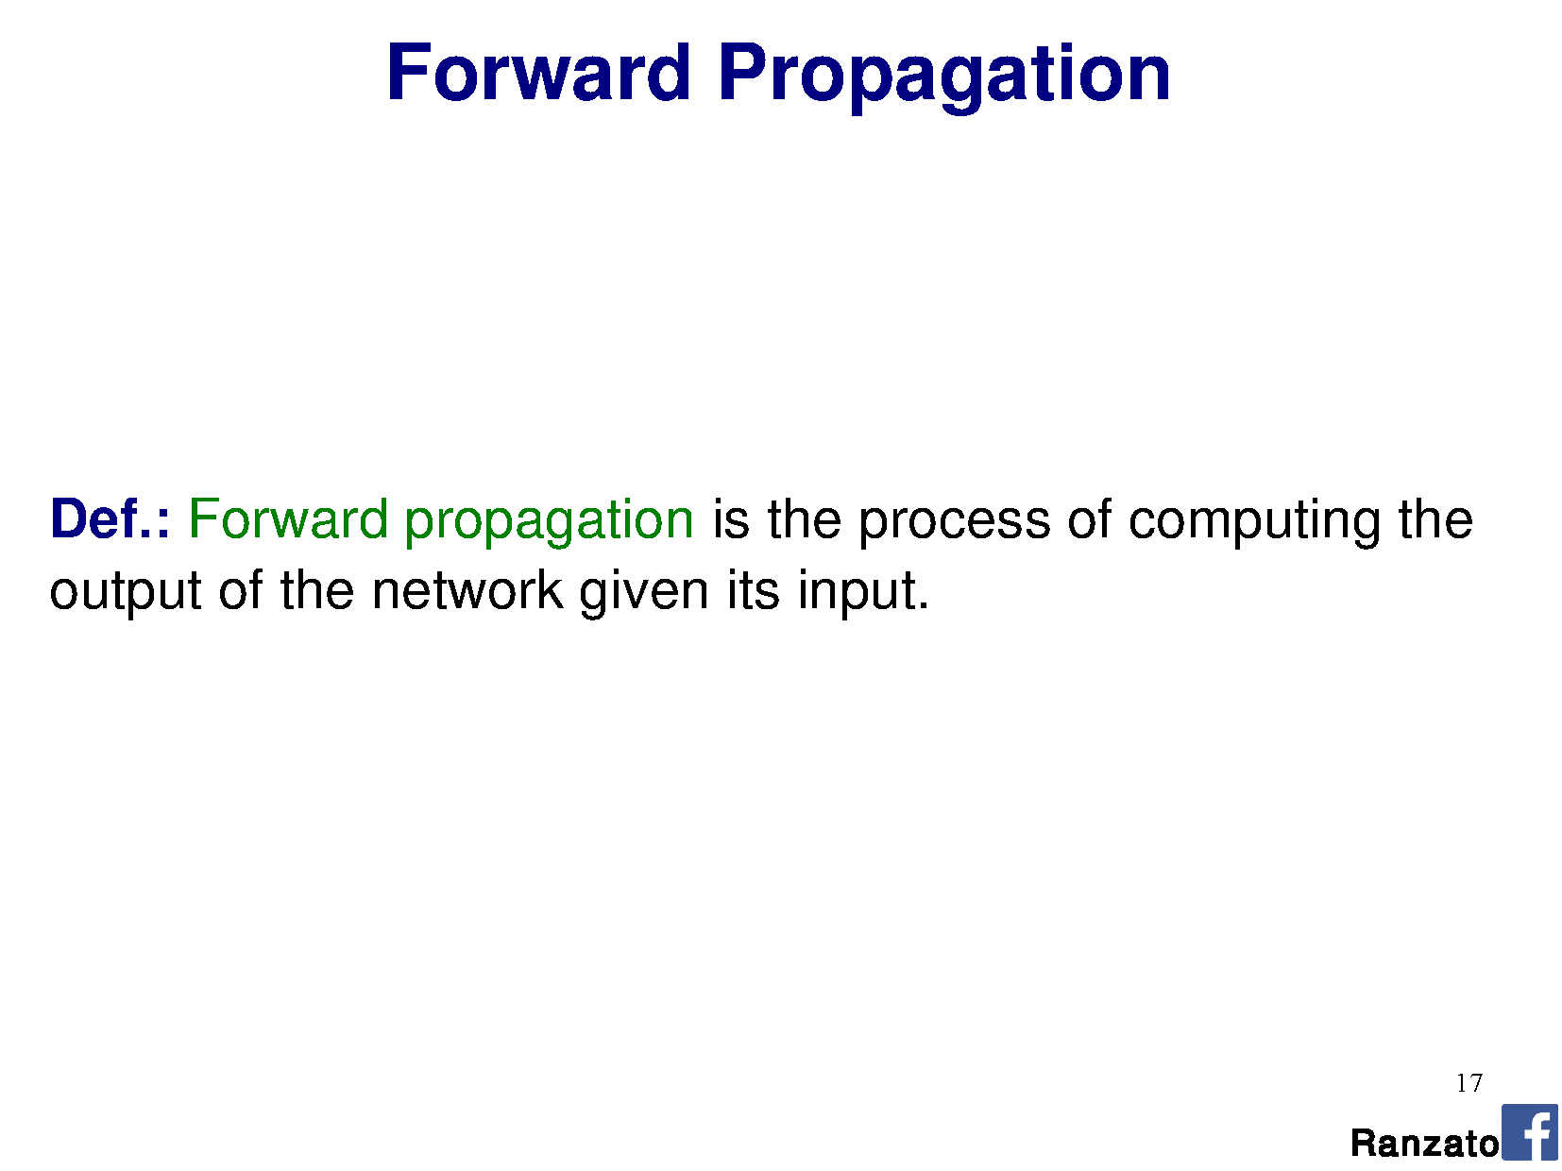

Slide 31
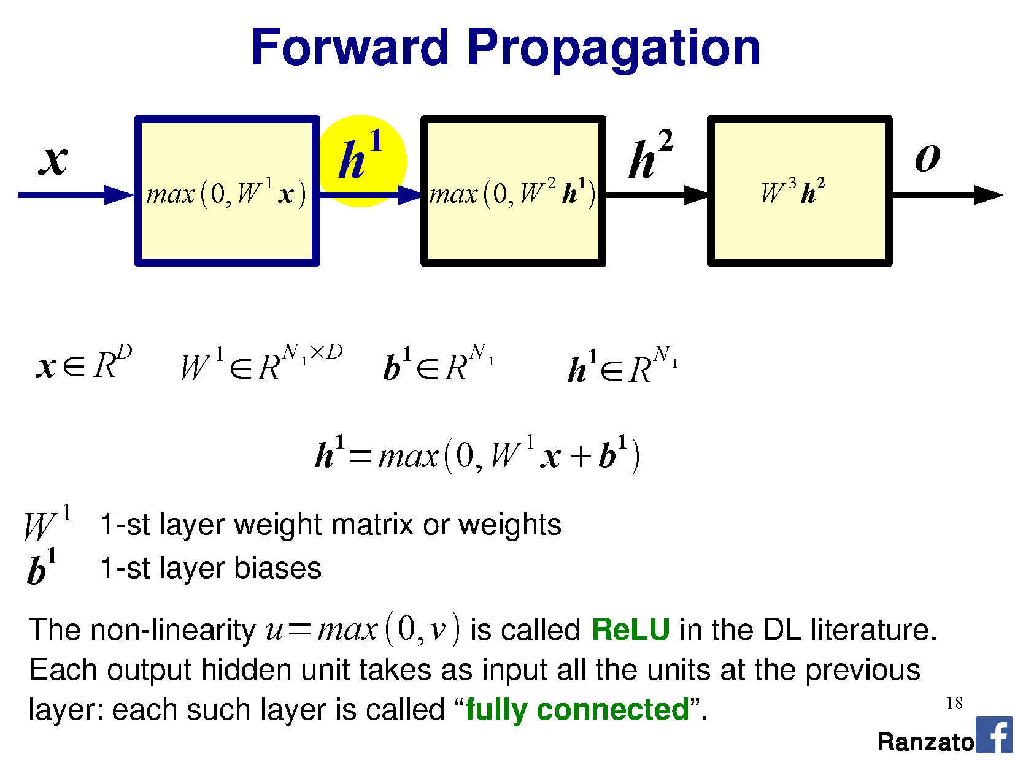

Slide 32
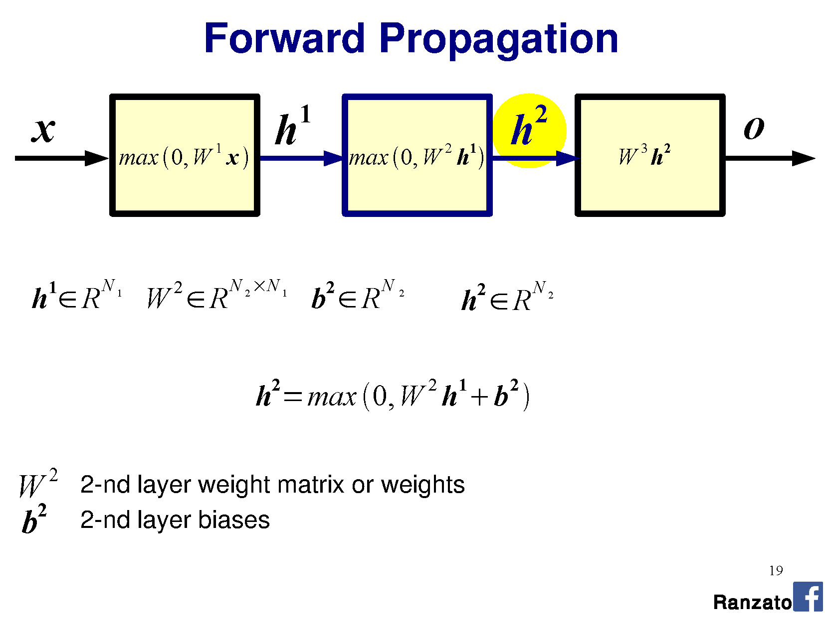

Slide 33
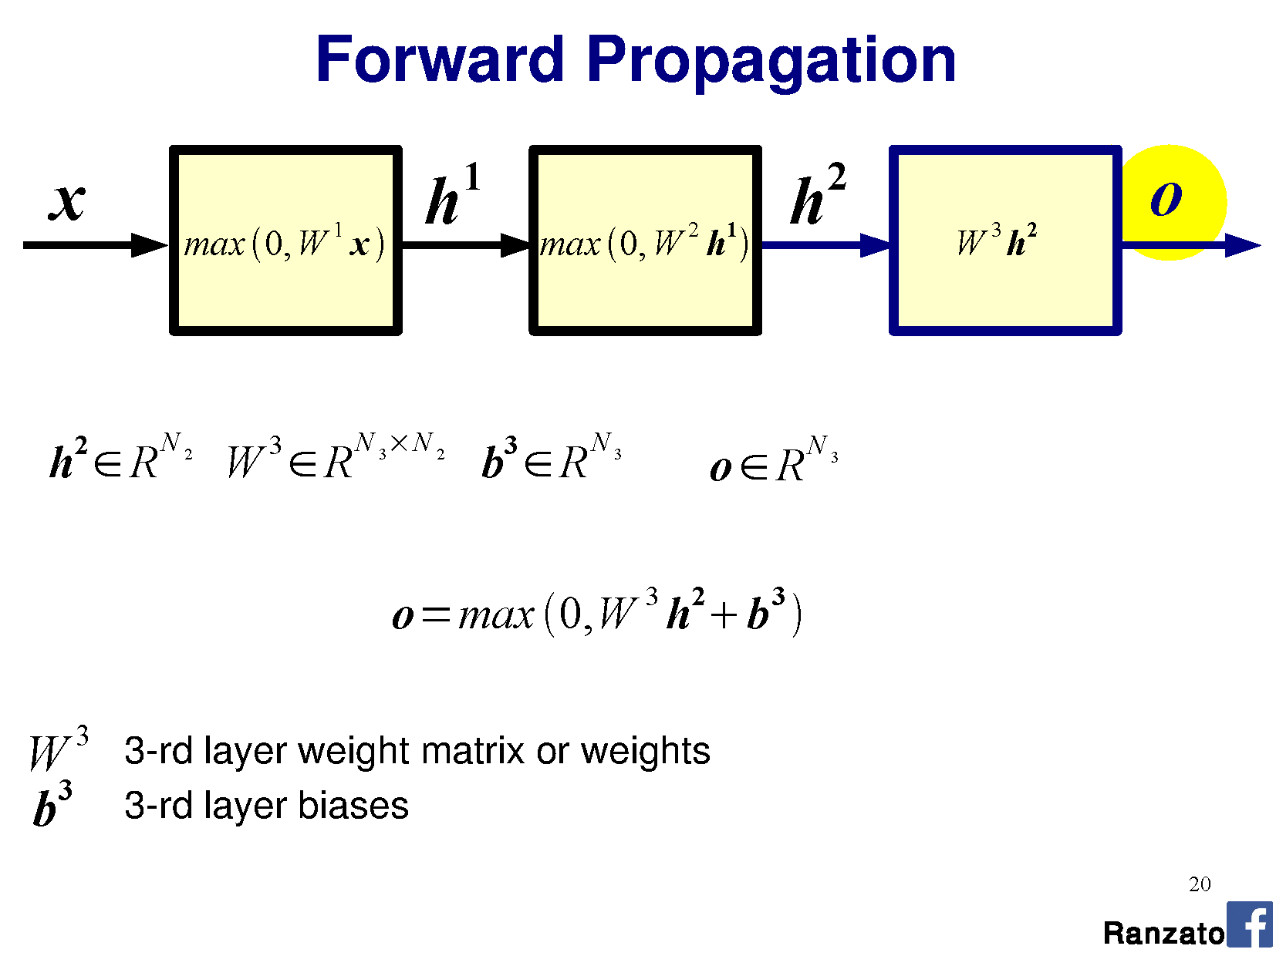

Slide 34
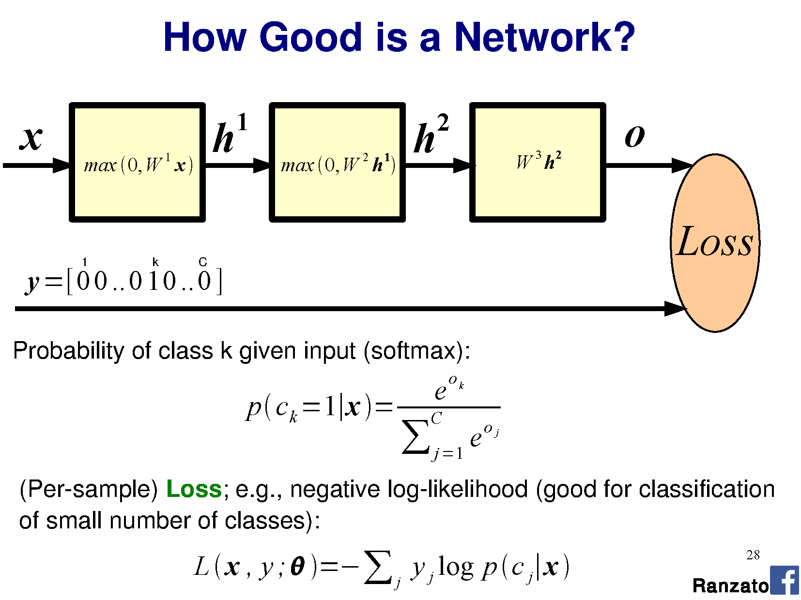

Slide 35
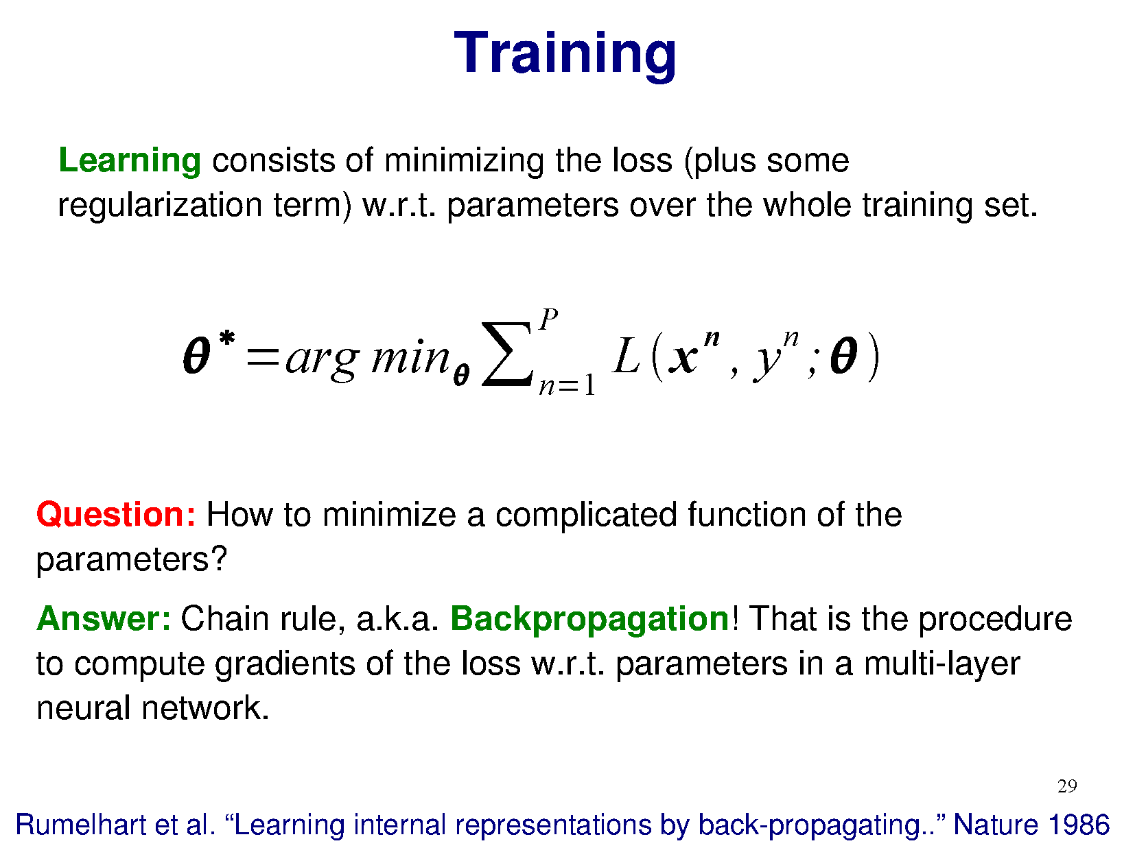

Slide 36
Loss (and how it is good the network in the real world)
Loss is very important; the network adapt its weights to minimize the loss.
If the loss is poorly related with the task, the network will not be useful in practice, even if the optimization, after the training, is good.
Many types of loss exists.
A very simple one is the Mean Square Error (MSE) between the ground truth values and the output of the network.

Slide 37
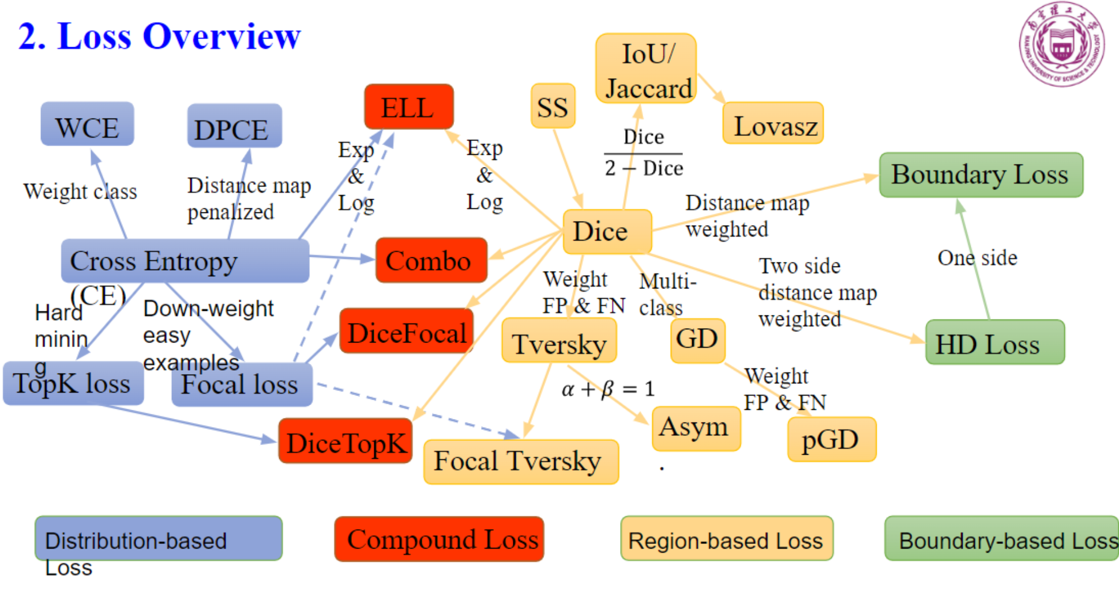
Loss (and how it is good the network in the real world)
Good if you want
precise boundaries
Good for the image
segmentation tasks

Slide 38
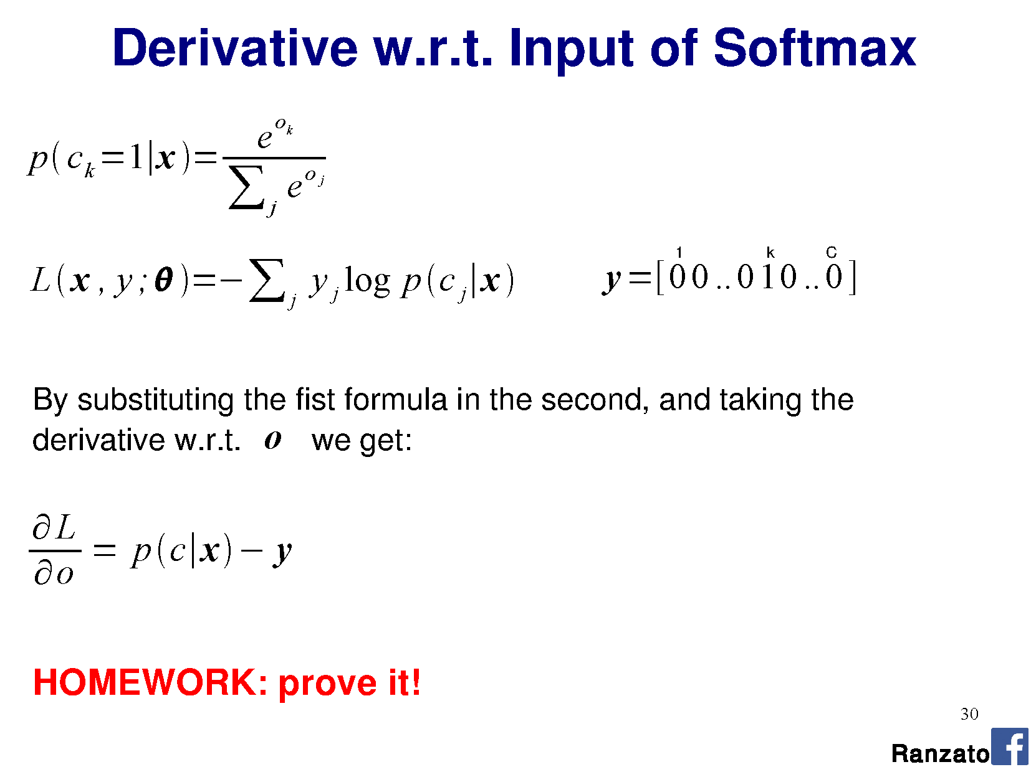

Slide 39
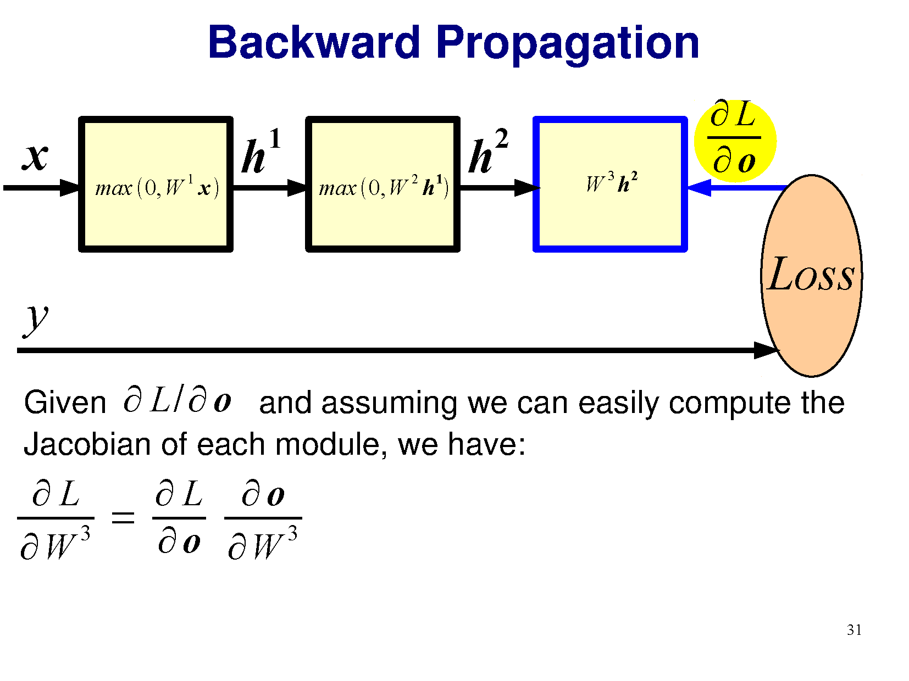

Slide 40
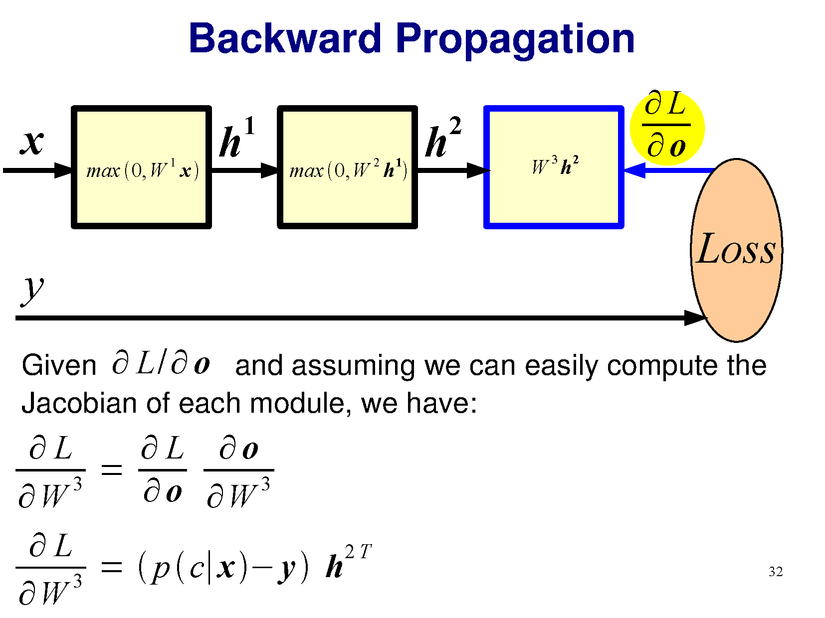

Slide 41
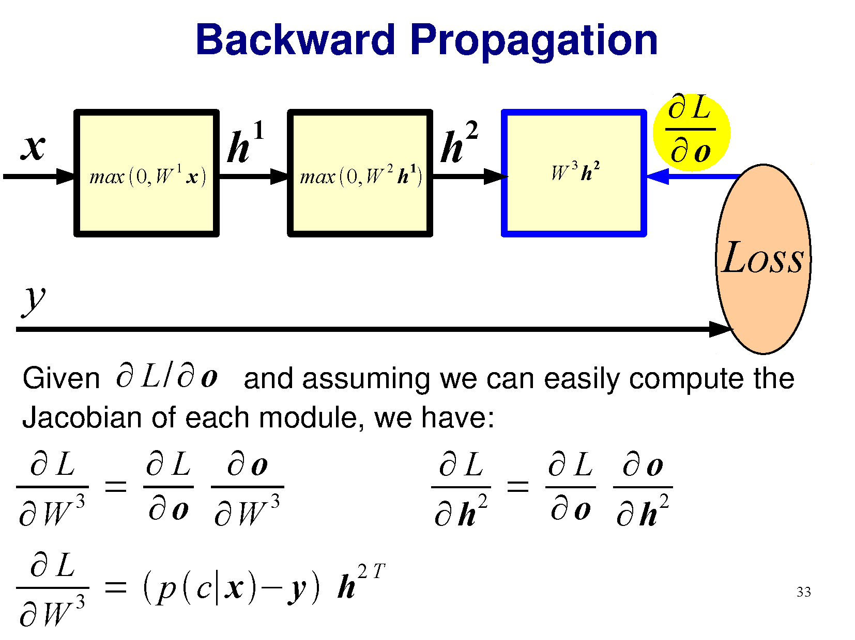

Slide 42
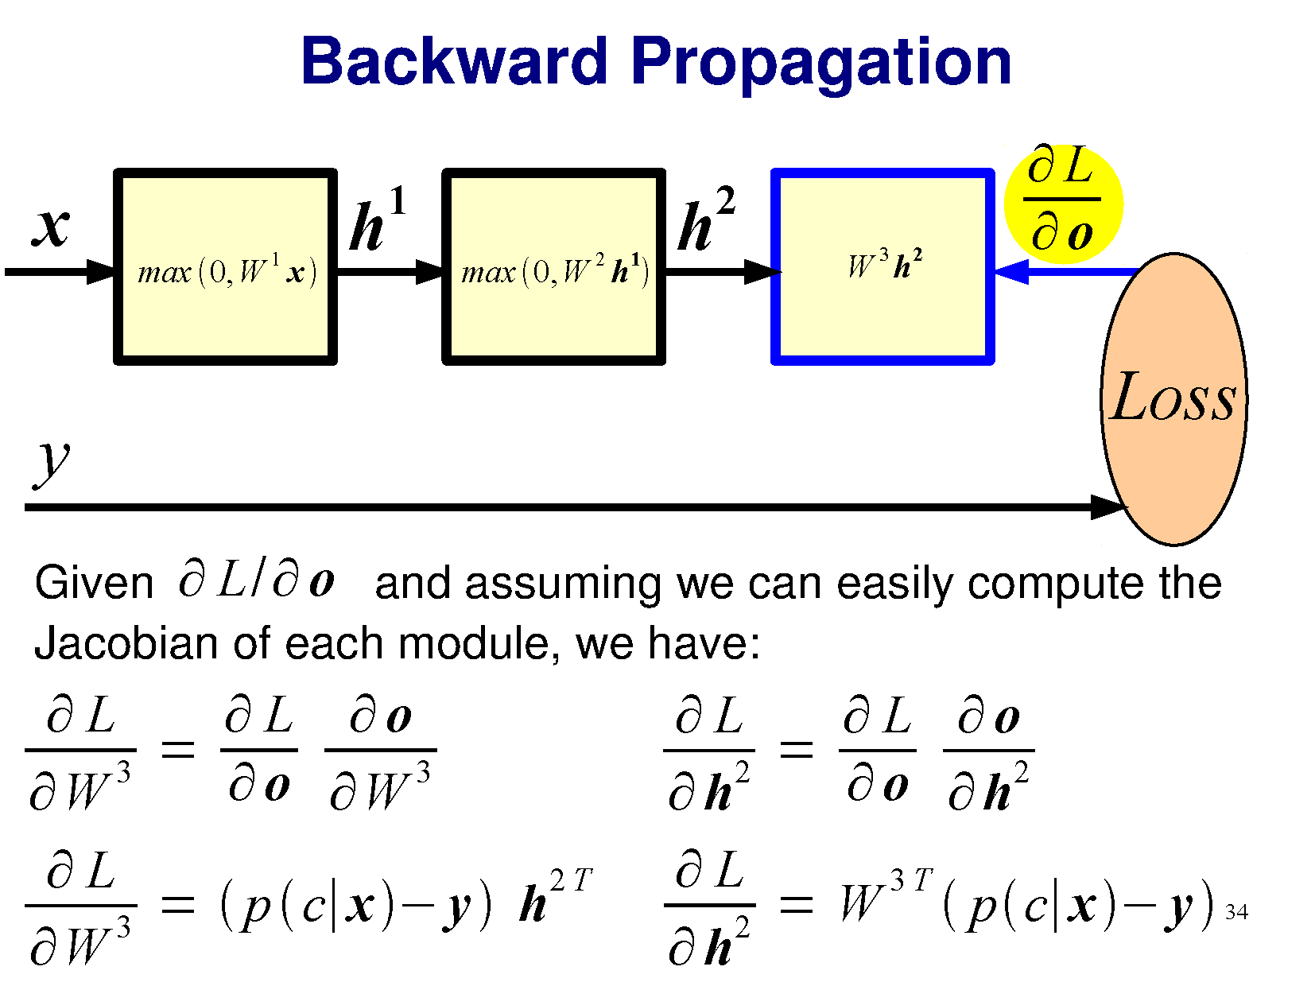

Slide 43
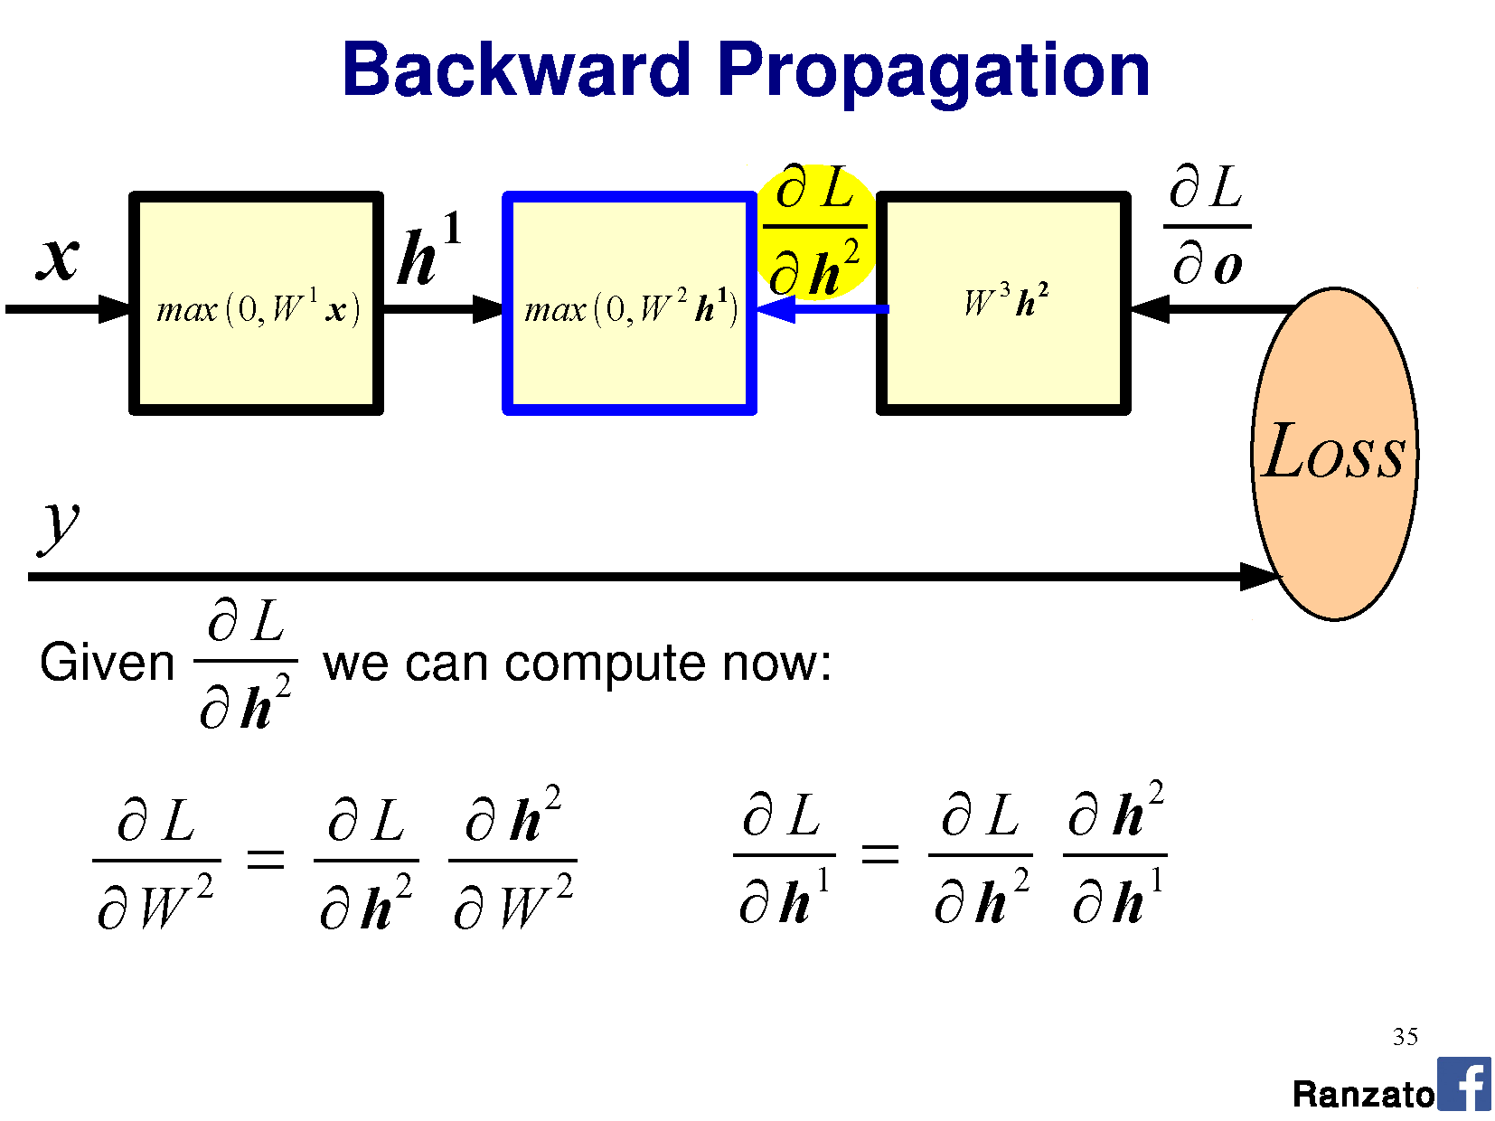

Slide 44
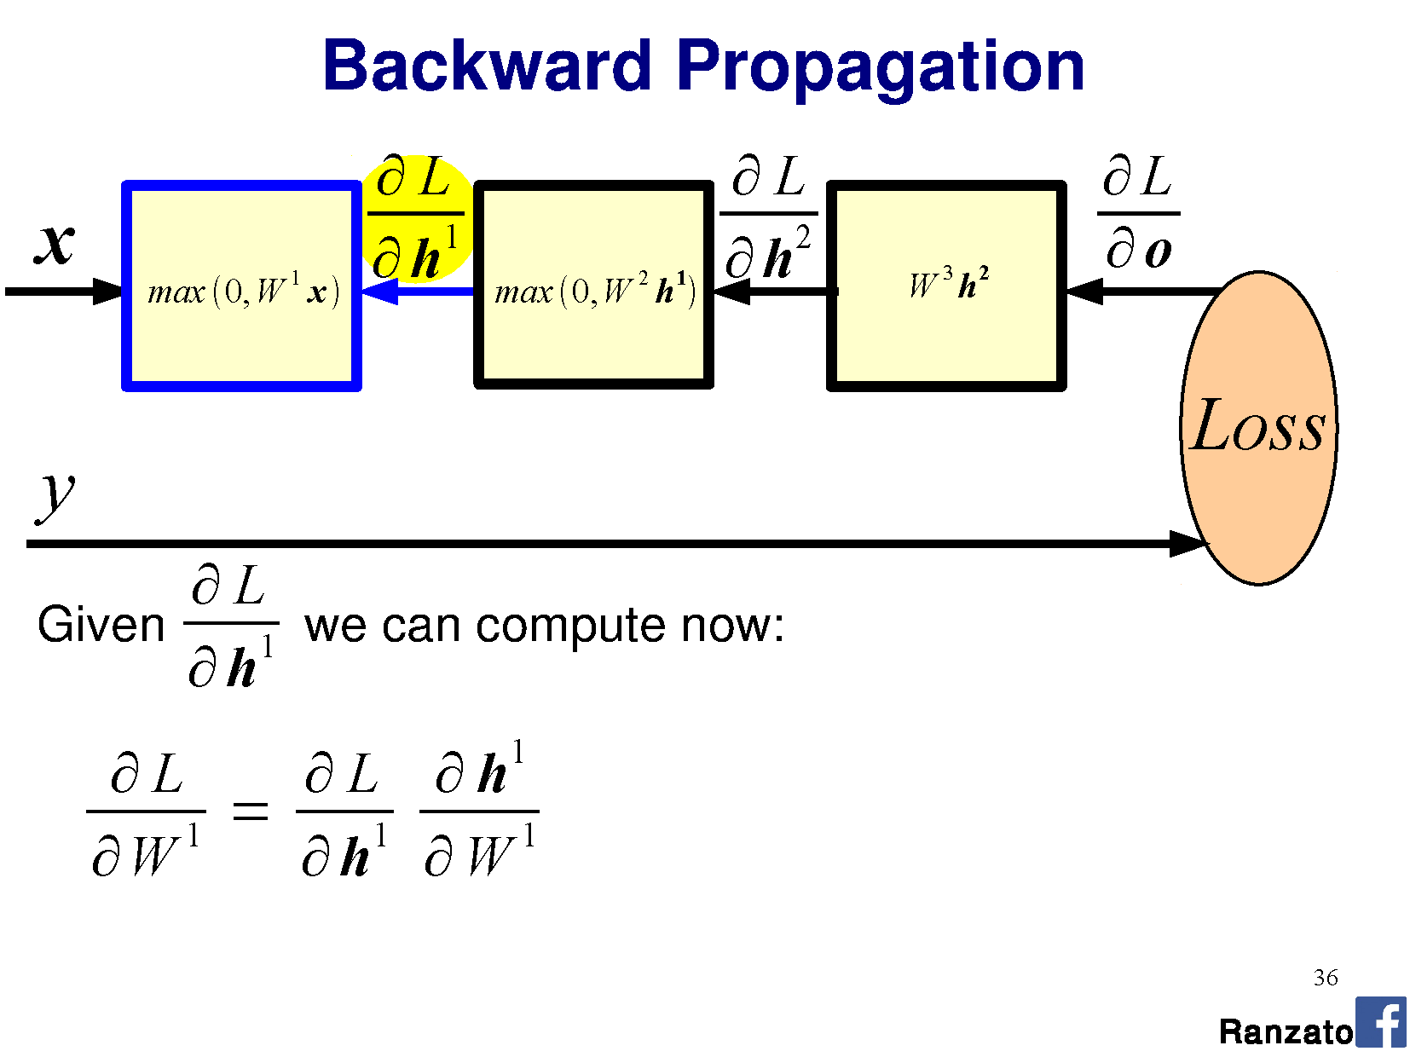

Slide 45
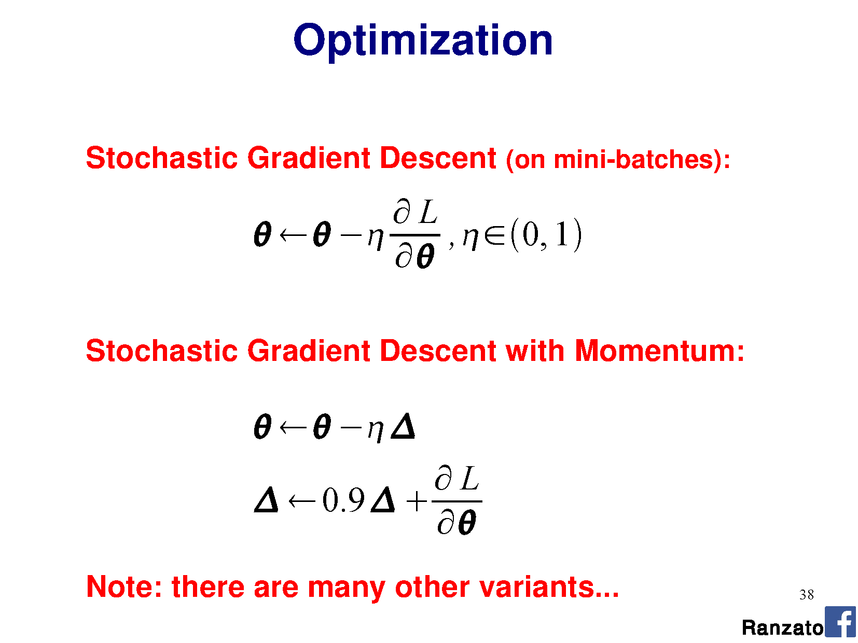

Slide 46
Optimization – Adam
Adam is an extension of stochastic gradient descent.
It has fast convergence, especially for large networks (a lot of weights).
Adam is a combination of two gradient descent methodologies:
Momentum → used to accelerate the gradient descent algorithm by taking into consideration the ‘exponentially weighted average’ of the gradients. Using averages makes the algorithm converge towards the minima in a faster pace.
Root Mean Square Propagation (RMSP) → RMSprop is an adaptive learning algorithm that tries to improve AdaGrad. Instead of taking the cumulative sum of squared gradients like in AdaGrad, it takes the ‘exponential moving average’.

Slide 47
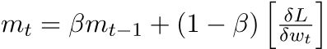
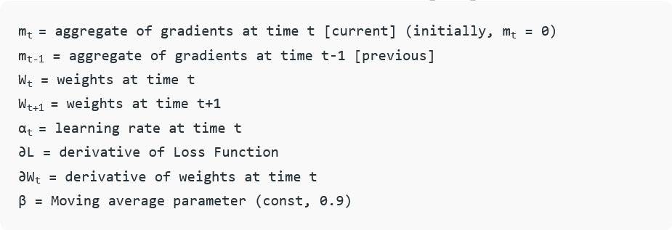
Optimization – Adam
Momentum

Slide 48
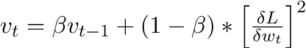
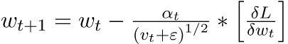
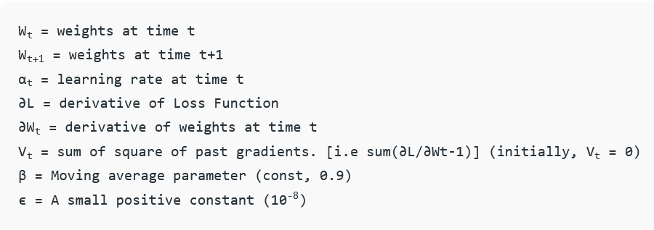
Optimization – Adam
Root Mean Square Propagation (RMSP):

Slide 49
Training dataset and network optimization – terminology
Typically, a small set of training samples is assembled together and given as input to the network during the forward pass
This set is called mini-batch or batch, the number of samples is the batch size
Typical batch size ranges from 4 to 64-128. The size of the batch size influences the weight updates (we will see more on this point later).
When all the data of the training dataset are given in input to the network, we say that the network has been trained for one epoch
Iterations is the number of batch needed for one epoch (number of samples / batch size).
One epoch is not sufficient to optimize the network (depending on the learning rate, many epochs are required).

Slide 50
Takeaway message about training
Neural networks can have different architectures; the optimization algorithm is always the same: the Back Propagation (BP).
Deep neural networks have many many layers (deep) w.r.t standard neural networks.
The final weights (optimal one) depend on the architecture, on the data, and on the loss.
The knowledge extracted from the dataset is catch by the weights of the network.
Data play a fundamental role (see next slide).

Slide 51
Takeaway message about data
Network optimization depends heavily on the input data → data quality is fundamental.
Data should be representative. Data should be clean (e.g. no labels’ errors).
FAIR (Facebook AI Research laboratory) leitmotive “garbage in → garbage out”
We will discuss this point in our context in the module (“How to prepare a training dataset”).

Slide 52
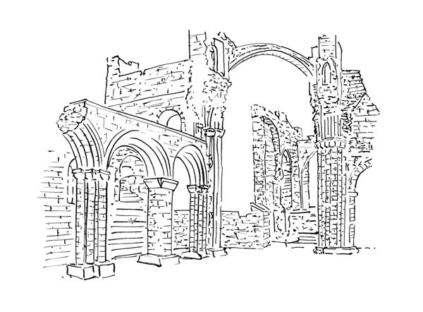
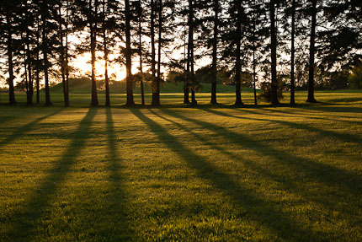
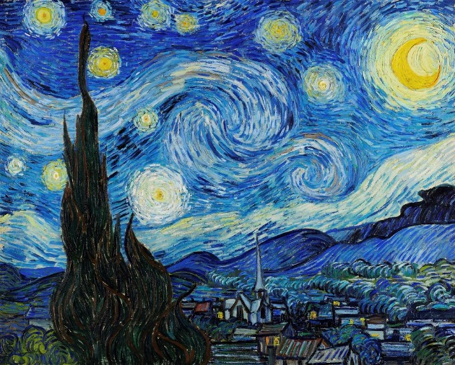
Optimization and domain
A network is optimized using a certain dataset. The dataset can contain data coming from one domain or different domains.
Example of domains:
Digital Photographs
Paintings
Sketches

Slide 53
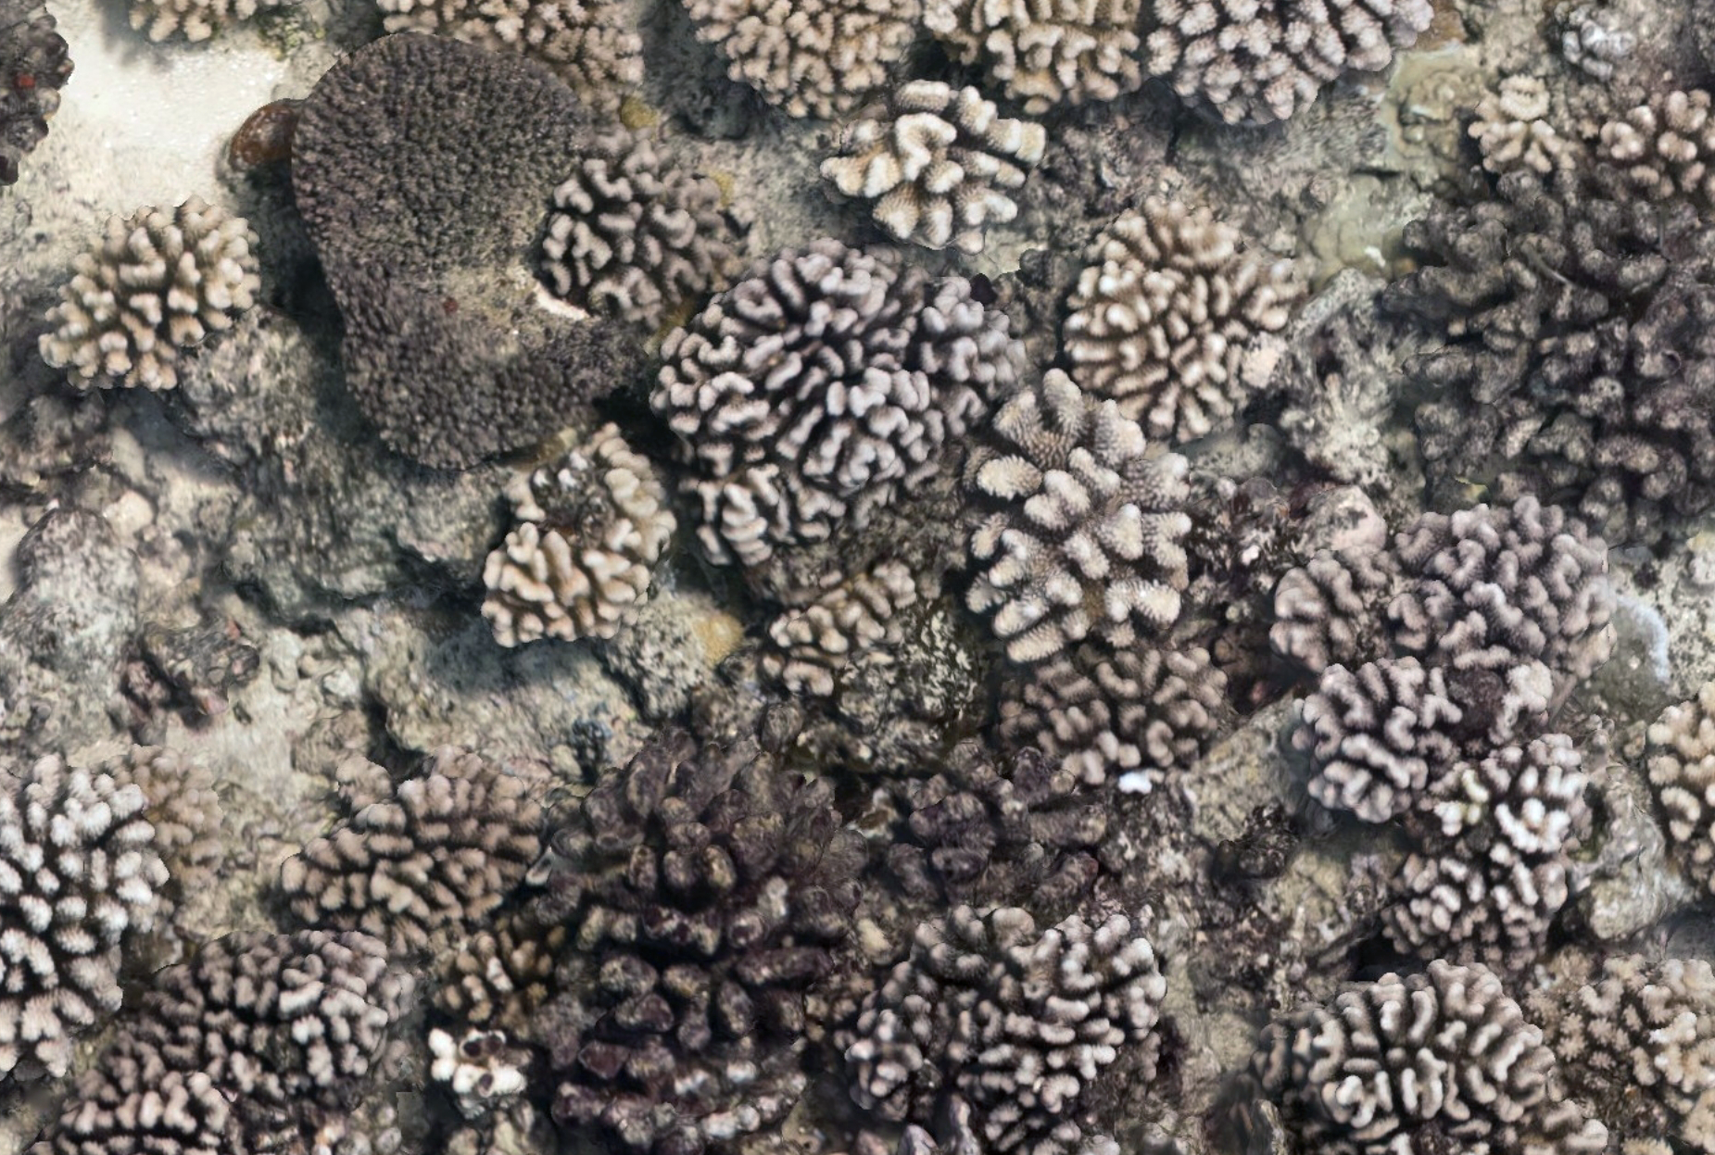
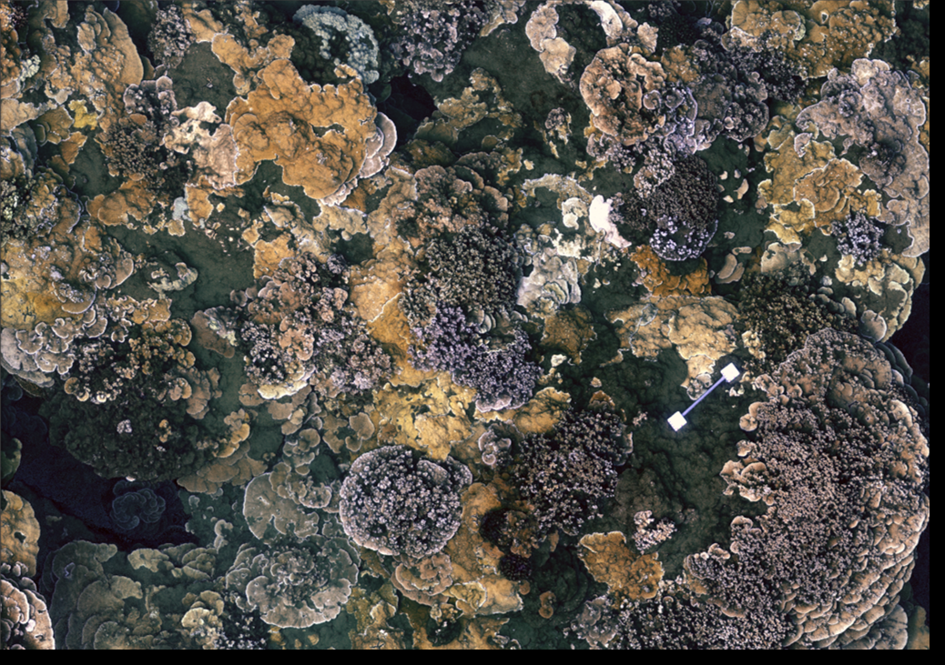
Optimization and domain
An example of different domains in our context: orthomosaics and orthoprojections
A network trained on orthomosaics, may not work on orthoprojection of the same site
Orthomosaic
Orthoprojections

Slide 54
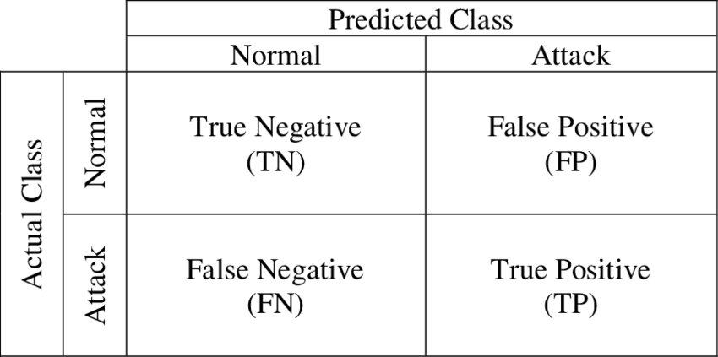
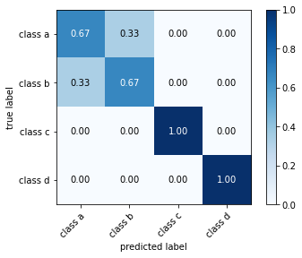
Model evaluation – accuracy
Confusion matrix of a binary classifier
Confusion matrix

Slide 55
Model evaluation – IoU
Predicted
Intersection over Union (IoU)
IoU = area of overlap / area of union
Intersection
Ground truth
Union

Slide 56
Convolutional Neural Networks (CNN)

Slide 57
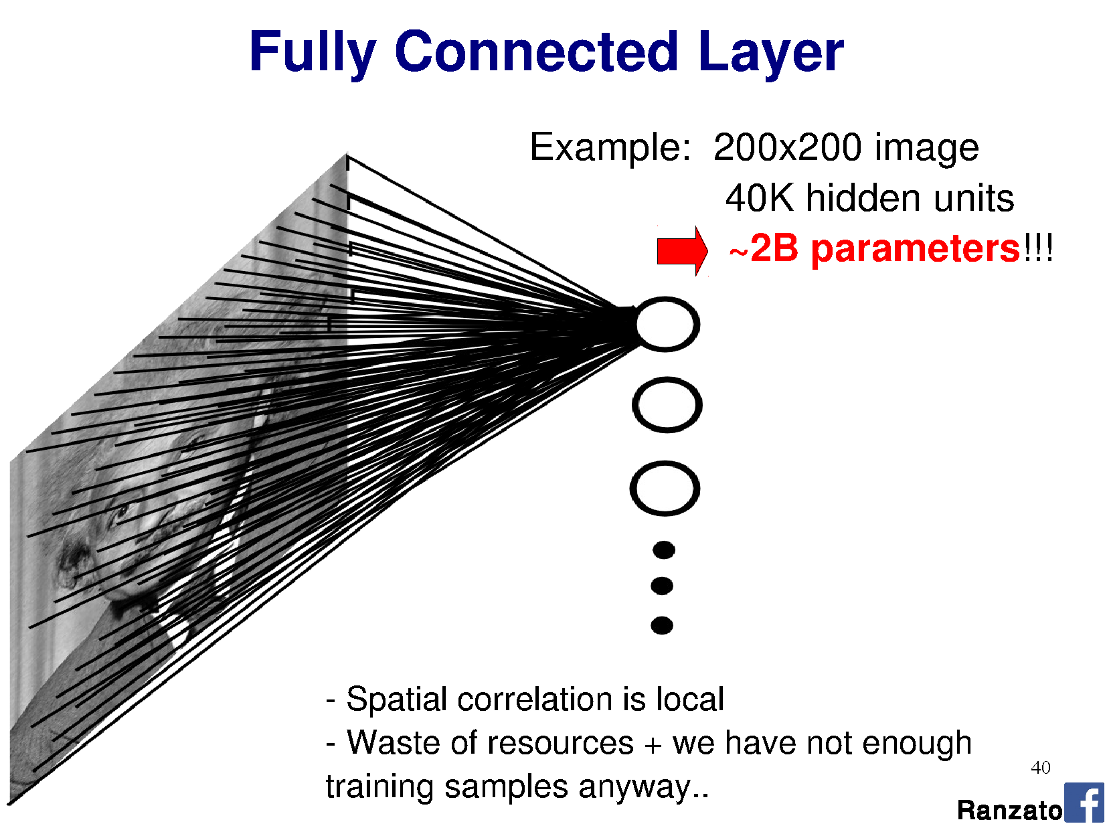

Slide 58
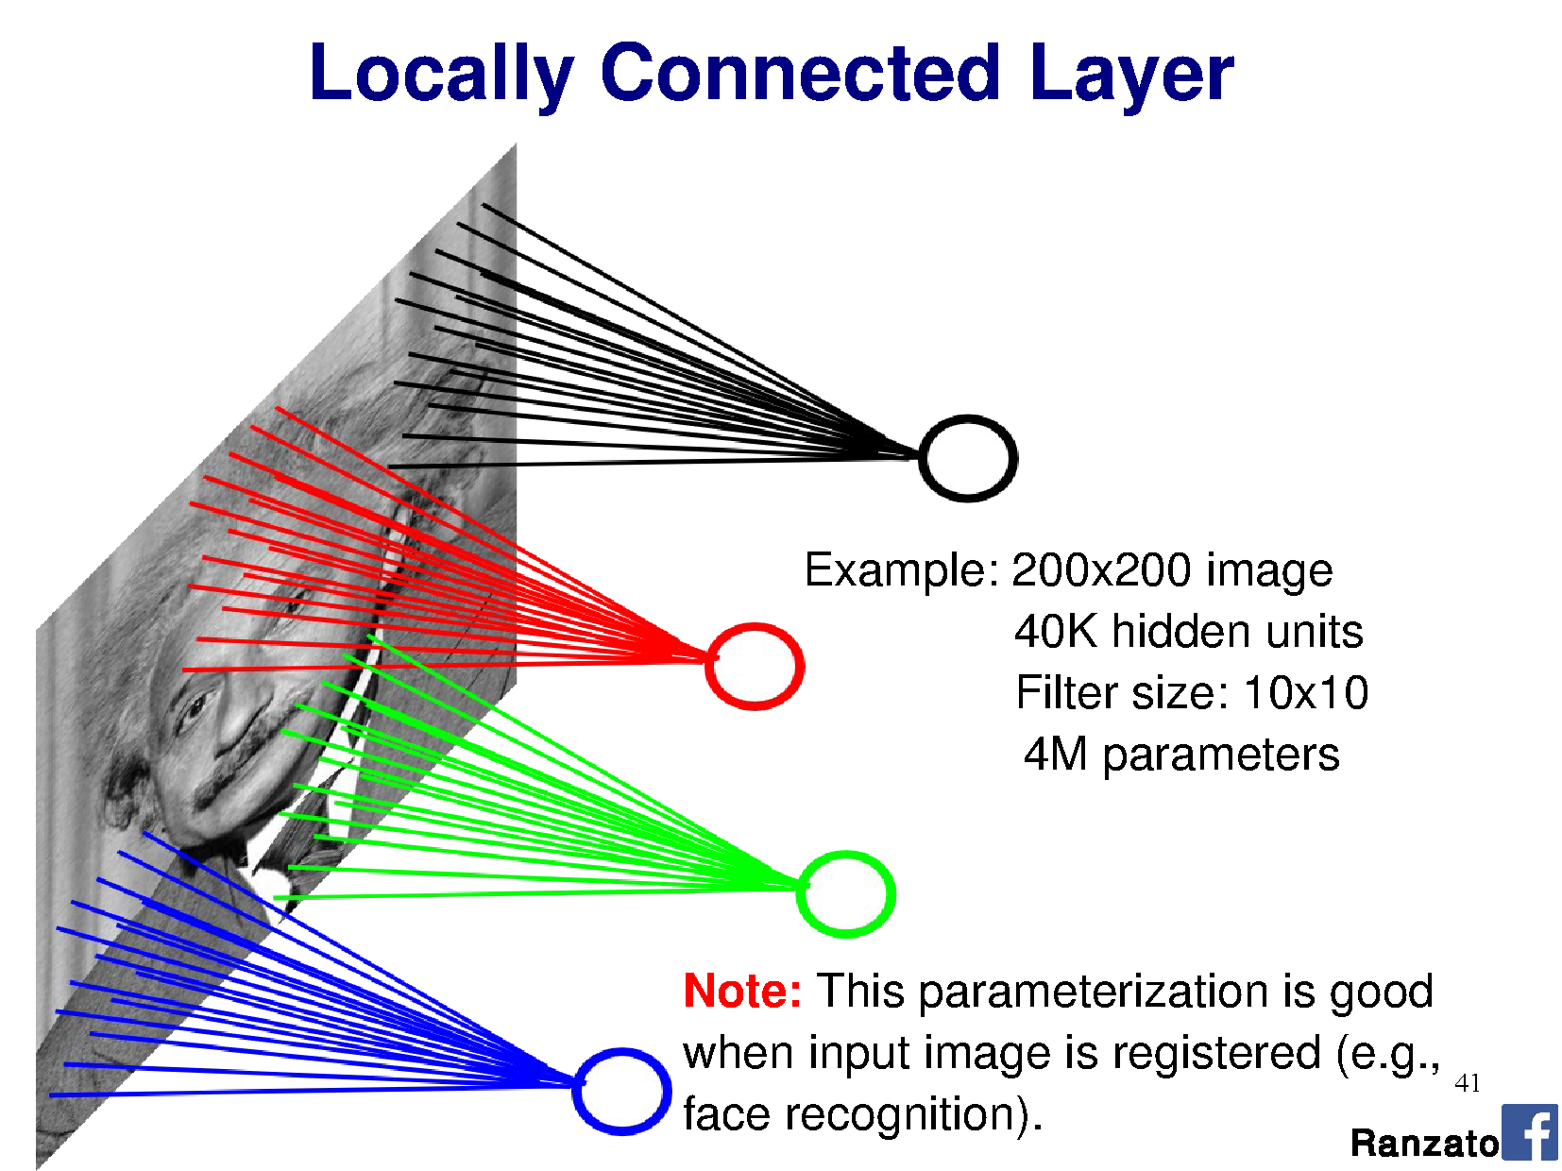

Slide 59


Slide 60


Slide 61


Slide 62


Slide 63


Slide 64


Slide 65


Slide 66


Slide 67


Slide 68


Slide 69


Slide 70


Slide 71


Slide 72


Slide 73


Slide 74


Slide 75


Slide 76


Slide 77


Slide 78


Slide 79


Slide 80


Slide 81


Slide 82


Slide 83


Slide 84


Slide 85


Convolutional Neural Networks (CNNs) on images

Slide 86


Slide 87


Slide 88


Slide 89


Slide 90

Applications of CNN

Slide 91

Applications of CNN

Slide 92

Applications of CNN

Slide 93
CNN architectures

Slide 94


Slide 95


Slide 96


Slide 97


Slide 98

Deep Neural Network – Vanishing gradient
Network is going deeper and deeper (billions of weights) → increase the number of layers and parameters may cause vanishing gradient problem.
As the backpropagation algorithm advances backward from the output layer towards the input layer, the gradients often get smaller and smaller and approach zero causing the weights of the lower layers nearly unchanged. This is known as the vanishing gradients problem.
Certain activation functions, like the logistic function (sigmoid) shrink and transform a larger input space into a smaller output space (e.g. in the range of [0,1]). Where the finctiom saturate the derivatives may go zero.

Slide 99


Deep Neural Network – Vanishing gradient
For the analogous reasons, gradient can also explode.
Also, weights initialization may lead to unstable updates of the weights (initial large values).
Solutions:
Initialize weights properly (e.g. Xavier initialization)
Using non-saturating activation functions like ReLU
Insert residual blocks

Slide 100
TRANSFER LEARNING, FINE-TUNING, AND FOUNDATIONAL MODELS

Slide 101
Transfer learning
Transfer learning regards the exploiting of the knowledge gathered by one model to solve a specific task to solve a different task (or the same task on different data).
It is not strictly related to neural networks, it is a broad machine learning concept.
In deep learning this means to get a network trained for a specific task and use it as a starting point to learn another task exploiting the information previously learned.
Example: a classifiers that segment cats to a classifier that segments dogs
It is «cheaper» (less computation and less data are required) than training-from-scratch (training the network starting from random weights).

Slide 102
Fine-tuning
Fine-tuning is a specialization of transfer learning. It is the process of adapting a pre-trained model for specific tasks or use cases.
Fine-tuning consists into further train a model that has already been trained. Using the base model’s previous knowledge as a starting point, fine-tuning tailors the model by training it on a smaller, task-specific dataset.
While that task-specific dataset could theoretically have been used for the initial training, training a large model from scratch on a small dataset risks overfitting (the model learn to perform well on the training examples, but not generalize well to other data).
→ Fine-tuning makes possible to exploit the broad knowledge gained from pre-training on a massive set of data to build a model target to more specific context.
Given the increasing progress and diffusion of open source foundation models, it is possible to obtain specific task models saving financial and computational resources.

Slide 103

Example: classification
Encoder
Classifier head

Slide 104

Example: semantic segmentation

Slide 105
How does fine-tuning work?
Typically, the encoder is freeze during fine-tuning (weights not change during the new training).
So, the visual features extraction parts exploit the previously learned knowledge → small dataset may be sufficient to obtain good performance !
The weights of the classifier head / decoder changes during the new training w.r.t the original network.
TagLab has a complex but effective strategy to achieve this, we will see later.

Slide 106
Catastrophic forgetting
Transfer learning and fine-tuning may suffers of catastrophic forgetting.
In simple words, all the previous knowledge is forget !
Example: the usual classifier of cats, after the fine-tuning, learns to recognize dogs but fails completely to recognize cats.

Slide 107
Foundational models
Building AI models takes resources, time, and lots of data !
Nowadays, one of the approach in AI, is to build models using huge dataset that can be adapted to different domains and different tasks with minimal fine-tuning. These models are called foundation models. Using fine-tuning, the foundation model can apply the general information the foundation model has learned to a specific task.
Zero-shot learning means that the same network can be used for different tasks without training.
Many foundation models are designed to be used in a zero-shot manner
Example, a LLM can perform summarization task or improve grammar changing only the prompt (no re-train needed).
Pay attention here! Foundation models provide the broad knowledge base, and zero-shot learning is a technique to utilize that knowledge for new, unseen tasks without extra training.

Slide 108
Foundational models – SAM
Let’s see an example

Slide 109
VISUAL TRANSFORMERS

Slide 110
Transformers
Trasformers have been originally developed in Natural Language Processing (NLP) revoluzioning the field. Today, many many people knows ChatGPT, for example.
→ After the success of transformers, the same ideas have been successfully applied in other field, like in visual tasks (Visual Transformers)
The same concepts have been applied to perform tasks (classification, segmentation) on point cloud.

Slide 111

Transformers (the origin)
Seminal paper: “Attention is all you need” (NIPS 2017)
RNN was used extensively for NLP
Advantages of Transformers w.r.t. RNN:
PARALLELIZATION
Transformers process all tokens in a sequence simultaneously, thanks to the self-attention mechanism.
RNNs process tokens sequentially, which makes training slower and harder to parallelize.
LONG-RANGE DEPENDENCY HANDLING
Transformers can directly attend to any part of the sequence, regardless of distance.
RNNs (and even LSTMs/GRUs) struggle with long-term dependencies due to vanishing gradients and limited memory.
MODULARITY
Transformers are more modular and easier to adapt to different tasks (e.g., BERT for classification, GPT for generation).

Slide 112



Vanishing gradient
Back Propagation Through Time (BPTT)
instead of Back Propagation
BPTT involves the computation of

Slide 113
Architecture
Decoder
Encoder

Slide 114


Encoder
Positional encoding
The transformer have no cognition of position of the tokens (no RNN or CNN) and distance between them, so an information about the position should be assigned to each token.
This is achieved by sum to the input embedding values depending on the position of the tokens inside the sequence.
From the original paper:
Input embedding
Each input token (e.g., a word of a sentence) is mapped to a fixed-size vector.
For example, the word "cat" might be mapped to a 512-dimensional vector.
The embedding is learned, so that the model learns the meaning of the different words.

Slide 115


Multi-head attention
Projection matrices

Slide 116

Single-head attention
Queries (Q): help to focus on what you're searching for. For each element in the input sequence query vector is computed. This query vector is used to "probe" or "look up" relevant information from all other elements in the sequence (e.g. Are you an adjective ? Are you a verb ?)
Keys (K): If queries are what you're searching for, keys are like the identifiers of available information. For every element in the input sequence, a key vector is computed. When a query is made, it is compared against all the keys to determine how well they match. The similarity between a query and a key indicates the relevance of the corresponding information.
Values (V): Once the relevance (similarity between a query and a key) is determined, the values are the actual information content that gets retrieved and aggregated. For every element in the input sequence, a value vector is computed. When a query matches well with a key, the corresponding value is given higher weight in the weighted sum that forms the attention output.

Slide 117
Single-head attention
Takeaway message: single-head attention learns all the aspects (the queries, the keys, the values) from the data given.

Slide 118
Self-attention
It is not been invented by the authors of the transformers.
Generally speaking, self-attention catches the relationships between tokens and weight them.
Self → it is the attention between the words of the sentences with the words of the same sentence.

Slide 119
Cross-attention vs self-attention
Self-attention: Queries (Q) come from the sequence itself. In self-attention, each element in a single sequence (e.g., a word in a sentence) generates its own Query, Key, and Value.
Encoder-Decoder Attention (Cross-Attention): queries come from the target sequence (e.g. translation task), while Keys and Values come from the source sequence. The Keys and Values are derived from the encoded source sequence (e.g., the original sentence in the source language) → this allows the decoder to "attend" to the most relevant parts of the input (source) sequence when generating each part of the output (target) sequence.

Slide 120
Visual Transformer (ViT)
Outstanding performance on NLP task inspire the application of the same ideas to visual tasks → Visual Transformer
Seminal paper: An Image is Worth 16x16 Words: Transformers for Image Recognition at Scale, ICLR2021.
Visual tasks attention was used in combination with CNN.
In the paper mentioned the authors demonstrated that CNN is not needed.

Slide 121

Visual Transformer - Architecture

Slide 122

Inspecting Visual Transformers
The model attends to image regions that are semantically relevant for classification.

Slide 123

Inspecting Visual Transformers

Slide 124
What’s next…
Using AI to annotate (segmentation) benthic ortho-images (our context)
Peculiarities and challenges
TagLab: an AI annotation tool for large area images
AI-based solutions adopted in TagLab
How to create your network in TagLab (dataset+training)

Slide 125
Thank you for your attention !

